Slide 1

2019.07.01
SK HR
Hybrid Integration Platform

Slide 4
TIBCO 소개

Slide 5
TIBCO, Global Leader in Integration

Slide 6

TIBCO, Global Leader in Charity?
미국의 흑인 억만장자가 대학 졸업식 축사를 하면서 졸업생 수백명의 학자금 대출을 모두 갚아주겠다고 깜짝 발표했다고 CNN 등이 19일(현지시간) 보도했다.
로버트 F 스미스(56)는 이날 조지아주 애틀랜타에 있는 모어하우스 대학 졸업식에서 연설을 하며 “우리 가족은 여러분의 버스에 연료를 약간 넣어 주려고 한다”면서 “여러분의 학자금 대출을 갚기 위해 지원금을 조성하고 있다”고 밝혔다.
데이비드 토머스 모어하우스대 총장은 졸업생 396명의 학자금 대출이 약 4000만달러(약 477억원)에 달한다고 추산했다.

Slide 7
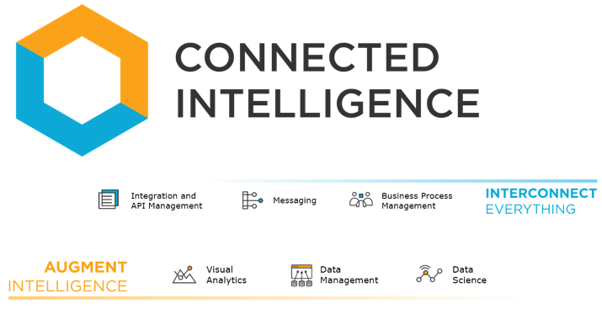
TIBCO’s Vision

Slide 8
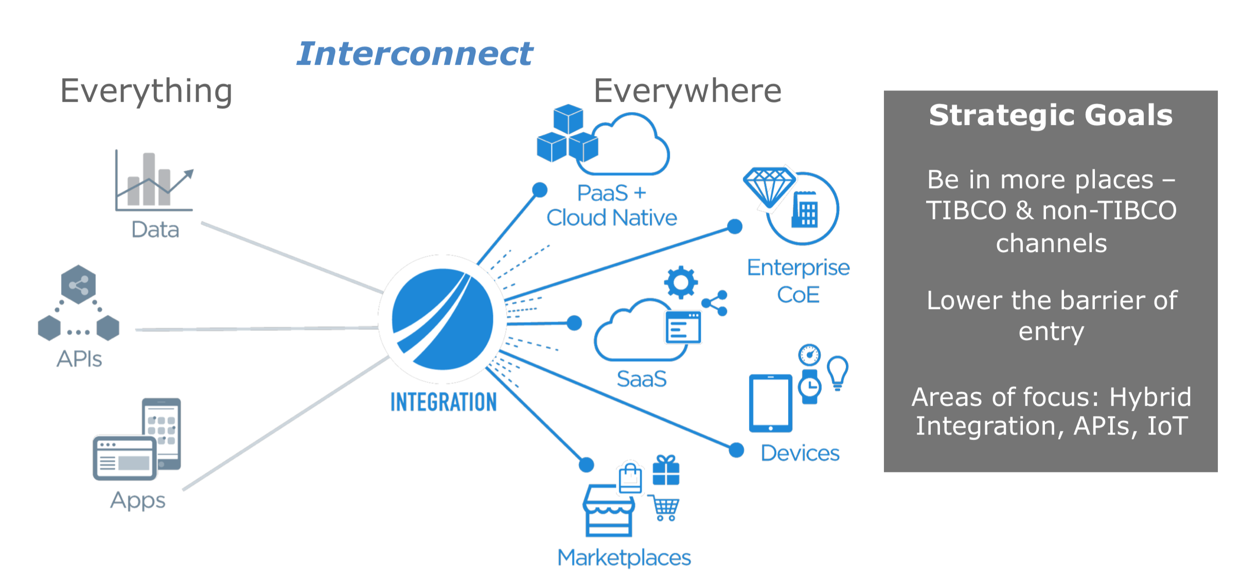
TIBCO’s Integration Vision

Slide 9
TIBCO’s Integration Vision

Slide 10
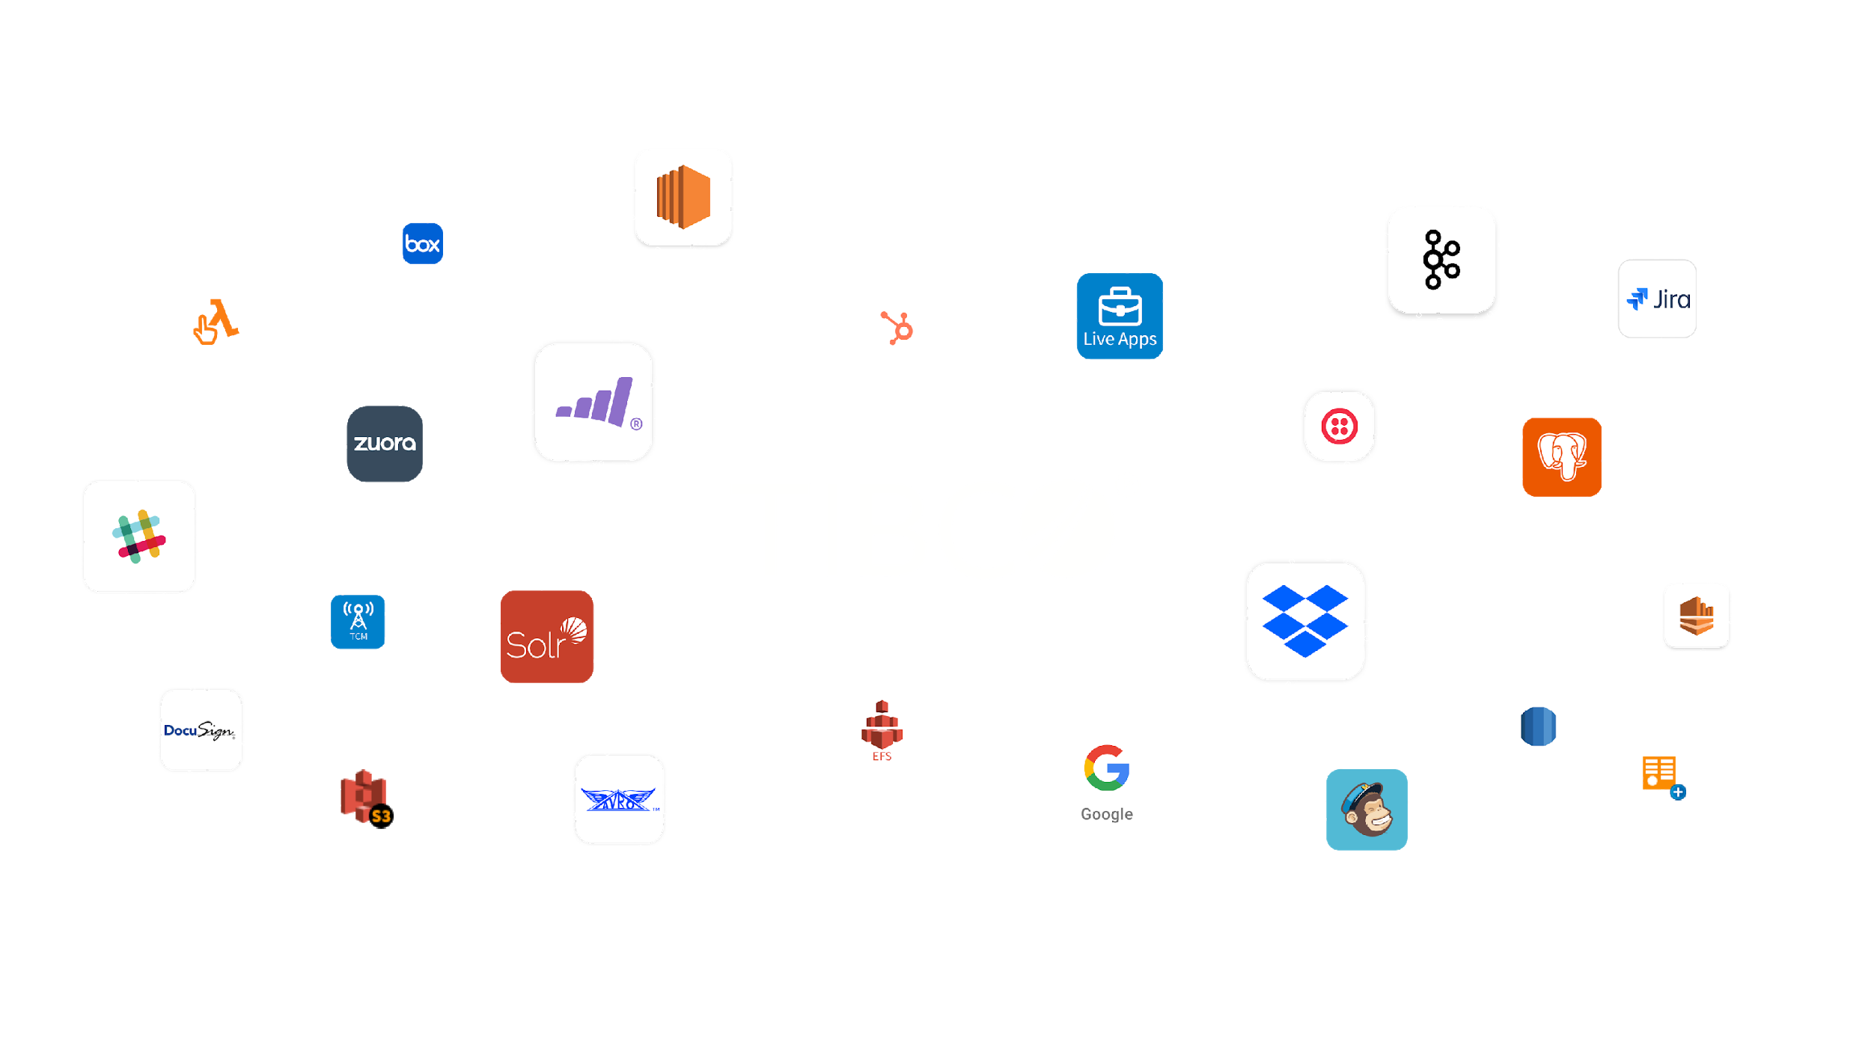
Integrate Anything Quickly and Easily
200+ commercial connectors, 750+ community connectors
Notes:
With TIBOC Cloud Integration, you will connect to anything, because you’ll have a large number of native connectors for for the most popular modern and legacy endpoints and technologies available to you.
You’ll connect quickly with connectors that are ready to use out of the box, thus your integrators will spend more time on valuable business logic, and less time on low-level connectivity code.
And you’ll connect confidently because you’ll be using proven connectors that are feature-rich, performance optimized, thoroughly tested, and secure - helping you ensure that your processes execute without disruption

Slide 11
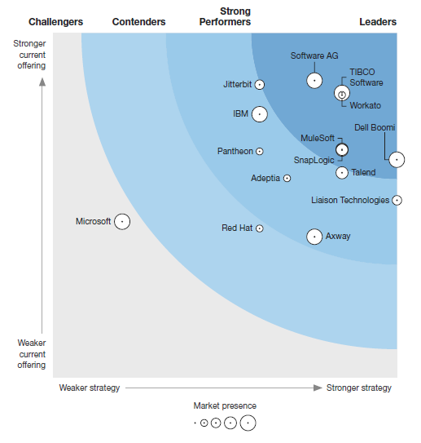



TIBCO Cloud Integration: The Market Leader
Forrester Wave: Strategic iPaaS and Hybrid Integration Platforms, Q1 2019
TCI Received Top Scores For All Integration Use Cases
TIBCO, the only vendor to receive top rating for all defined use cases (API creation and mgt., Data integration, Message Queueing, IoT integration, B2B integration)
TCI Addresses The Needs of All Personas
Supported users range from developers and integration specialists to citizen integrators
TIBCO’s Innovation Differentiates Us
Backed by statements from customer references the pace of innovation sets up apart
Download the Report
Notes:
TIBCOs leadership in the hybrid integration market segment is validated by industry analysts through their assessments of our solution and market position. As strong evidence of this, TIBCO was named THE leader in the Q1 2019 Forrester Wave: Strategic iPaaS and Hybrid Integration Platforms
We received the highest possible score in 14 criteria in the current offering category. We also received the highest possible score in the strategy category for the market approach criterion, and in the market presence category for the revenue and number of customers criteria.
In our view, these scores indicate our market share and proven customer success
You can download a complementary copy of this report from TIBCO.com at the link provided here

Slide 12
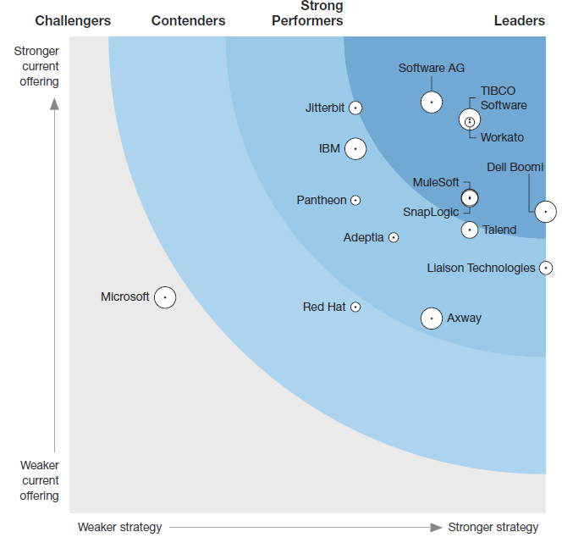
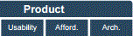
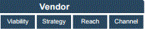




Market Recognition
Forrester
Info-Tech Research Group
TIBCO
IBM
Oracle
Software AG
MicroSoft
Individual strengths to find the best fit for your Enterprise Application Integration Aug. 2015
Strategic iPaaS And Hybrid Integration Platforms Forrester Wave : Q1 2019

Slide 13







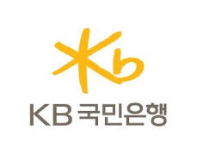
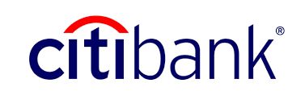
















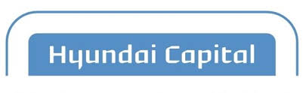



Customers
Notes:
Yet another capability that differentiates TIBCO CLoud Integration is the independence and flexibility it gives your business across several dimensions
First, you’ll run your integration applications wherever you want, either in the TIBCO Cloud, or in a hybrid environment across on-premesis, containers, public clouds, server less environments, and edge devices.
Second, you’ll consume TIBCO Cloud Integration how you want, with options of the TIBCO managed service or Pay-as-you-Go from public cloud marketplaces with unified billing
And finally, you’ll scale as you want by dynamically scaling peak loads on public cloud infrastructures - helping you adapt your integration needs to your business needs.

Slide 14
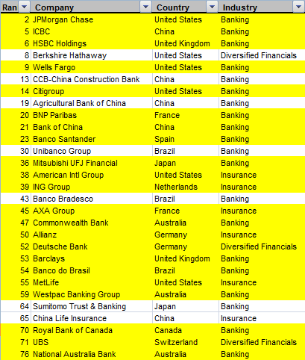

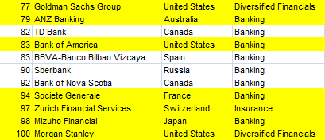















Customers
Notes:
Yet another capability that differentiates TIBCO CLoud Integration is the independence and flexibility it gives your business across several dimensions
First, you’ll run your integration applications wherever you want, either in the TIBCO Cloud, or in a hybrid environment across on-premesis, containers, public clouds, server less environments, and edge devices.
Second, you’ll consume TIBCO Cloud Integration how you want, with options of the TIBCO managed service or Pay-as-you-Go from public cloud marketplaces with unified billing
And finally, you’ll scale as you want by dynamically scaling peak loads on public cloud infrastructures - helping you adapt your integration needs to your business needs.

Slide 15
Who We Are
Global leader in …
On-Premise Integration : 이기종 시스템 통합
Hybrid Integration : 클라우드-로컬 시스템 통합
Cloud Integration : 멀티 클라우드 통합
Notes:
TIBCO offerings that enable integration have also been recognized by industry analysts. We have been ranked as a leader in the most recent Gartner Magic Quadrant for Full Lifecycle API management, and we have received among the highest vendor placement in the recent Ovum Decision Matrix for Middleware-as-a Service

Slide 16
통합 요건 별 TIBCO의 역량

Slide 17
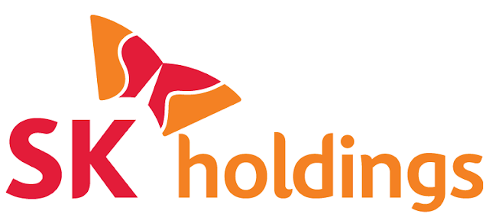

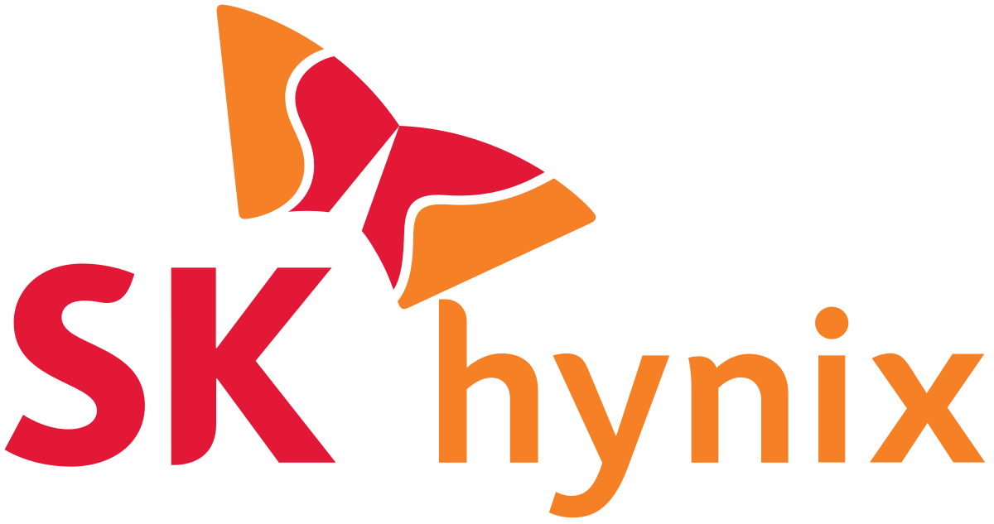
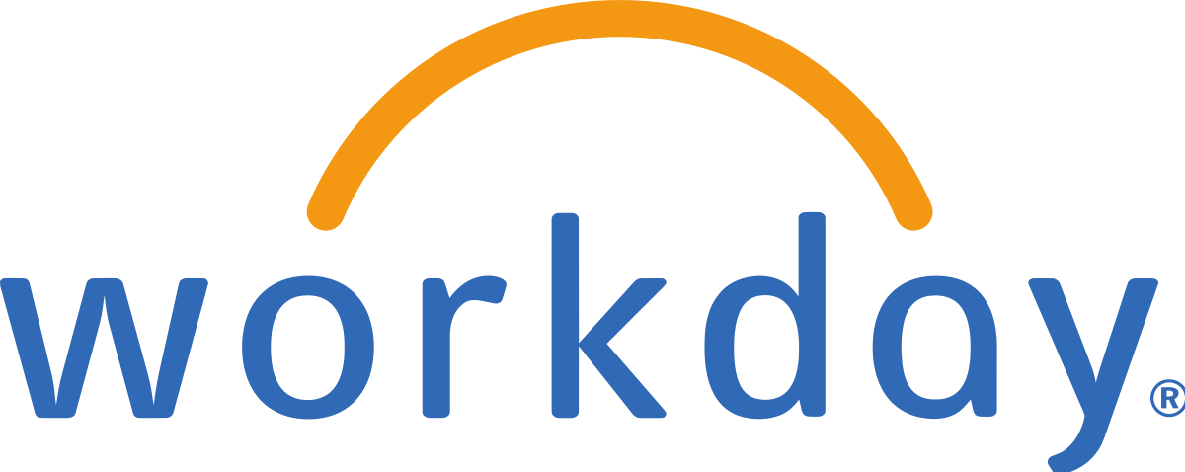



Background
Legacy
Legacy
Legacy
Legacy
Shared Data Assets
Legacy
Legacy
Notes:
Yet another capability that differentiates TIBCO CLoud Integration is the independence and flexibility it gives your business across several dimensions
First, you’ll run your integration applications wherever you want, either in the TIBCO Cloud, or in a hybrid environment across on-premesis, containers, public clouds, server less environments, and edge devices.
Second, you’ll consume TIBCO Cloud Integration how you want, with options of the TIBCO managed service or Pay-as-you-Go from public cloud marketplaces with unified billing
And finally, you’ll scale as you want by dynamically scaling peak loads on public cloud infrastructures - helping you adapt your integration needs to your business needs.

Slide 18
Hybrid Integration
Legacy
On-Premise Integration
Legacy
Legacy
Cloud Integration
Workday Integration
Legacy
Shared Data Assets
Legacy
Legacy
Notes:
Yet another capability that differentiates TIBCO CLoud Integration is the independence and flexibility it gives your business across several dimensions
First, you’ll run your integration applications wherever you want, either in the TIBCO Cloud, or in a hybrid environment across on-premesis, containers, public clouds, server less environments, and edge devices.
Second, you’ll consume TIBCO Cloud Integration how you want, with options of the TIBCO managed service or Pay-as-you-Go from public cloud marketplaces with unified billing
And finally, you’ll scale as you want by dynamically scaling peak loads on public cloud infrastructures - helping you adapt your integration needs to your business needs.

Slide 19
1. On-Premise Integration
Legacy
On-Premise Integration
Legacy
Legacy
Legacy
Shared Data Assets
Legacy
Legacy
Notes:
Yet another capability that differentiates TIBCO CLoud Integration is the independence and flexibility it gives your business across several dimensions
First, you’ll run your integration applications wherever you want, either in the TIBCO Cloud, or in a hybrid environment across on-premesis, containers, public clouds, server less environments, and edge devices.
Second, you’ll consume TIBCO Cloud Integration how you want, with options of the TIBCO managed service or Pay-as-you-Go from public cloud marketplaces with unified billing
And finally, you’ll scale as you want by dynamically scaling peak loads on public cloud infrastructures - helping you adapt your integration needs to your business needs.

Slide 20

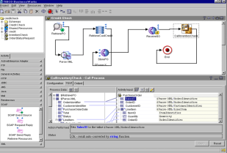
Concept
On-Premise
Integration
Workday
Plug-in
Real-time
Batch
sFTP
Plug-in
BusinessWorks
Process #1
Process #2
Process #3
Process #4
Process #5
Transform
Routing
Transaction
Logging
Security
EMS
SAP
Plug-in
DBMS
Plug-in
sFTP
Plug-in
TCP/IP
Plug-in
High-Speed Message-Oriented Middleware
Legacy HR
ERP
RDBMS
File
J2EE
WAS
Notes:
Yet another capability that differentiates TIBCO CLoud Integration is the independence and flexibility it gives your business across several dimensions
First, you’ll run your integration applications wherever you want, either in the TIBCO Cloud, or in a hybrid environment across on-premesis, containers, public clouds, server less environments, and edge devices.
Second, you’ll consume TIBCO Cloud Integration how you want, with options of the TIBCO managed service or Pay-as-you-Go from public cloud marketplaces with unified billing
And finally, you’ll scale as you want by dynamically scaling peak loads on public cloud infrastructures - helping you adapt your integration needs to your business needs.

Slide 21
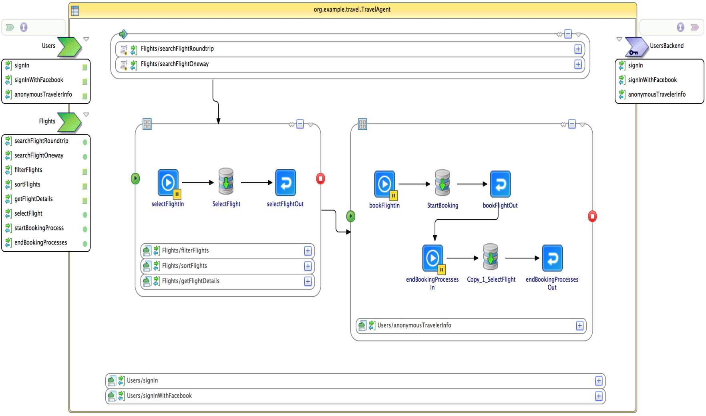
Operation
On-Premise
Integration
Process (Design Time)
어떤 activity를 trigger로
어느 source로부터
어떤 프로토콜 및 method를 통해
어떤 데이터를
어떤 포맷으로 읽어 들여
어떻게 변환하고 처리하여
어떤 포맷으로
어떤 프로토콜 및 method를 통해
어느 target에 전달할 것인가?
BusinessStudio
Notes:
Yet another capability that differentiates TIBCO CLoud Integration is the independence and flexibility it gives your business across several dimensions
First, you’ll run your integration applications wherever you want, either in the TIBCO Cloud, or in a hybrid environment across on-premesis, containers, public clouds, server less environments, and edge devices.
Second, you’ll consume TIBCO Cloud Integration how you want, with options of the TIBCO managed service or Pay-as-you-Go from public cloud marketplaces with unified billing
And finally, you’ll scale as you want by dynamically scaling peak loads on public cloud infrastructures - helping you adapt your integration needs to your business needs.

Slide 22

Operation
On-Premise
Integration
Process (Design Time)
Application (Run Time)
BusinessStudio
BusinessWorks
Notes:
Yet another capability that differentiates TIBCO CLoud Integration is the independence and flexibility it gives your business across several dimensions
First, you’ll run your integration applications wherever you want, either in the TIBCO Cloud, or in a hybrid environment across on-premesis, containers, public clouds, server less environments, and edge devices.
Second, you’ll consume TIBCO Cloud Integration how you want, with options of the TIBCO managed service or Pay-as-you-Go from public cloud marketplaces with unified billing
And finally, you’ll scale as you want by dynamically scaling peak loads on public cloud infrastructures - helping you adapt your integration needs to your business needs.

Slide 23
Things to Consider
On-Premise
Integration
Easy Integration : 다양한 기술 및 제품 연계
Productivity : 통합을 위한 개발 생산성 (Zero-code)
Performance : 업무 특성 반영한 프로세스
Fault Tolerance : 고가용성 HA 구성
Security : 접근제어 및 전문 암호화
Notes:
Yet another capability that differentiates TIBCO CLoud Integration is the independence and flexibility it gives your business across several dimensions
First, you’ll run your integration applications wherever you want, either in the TIBCO Cloud, or in a hybrid environment across on-premesis, containers, public clouds, server less environments, and edge devices.
Second, you’ll consume TIBCO Cloud Integration how you want, with options of the TIBCO managed service or Pay-as-you-Go from public cloud marketplaces with unified billing
And finally, you’ll scale as you want by dynamically scaling peak loads on public cloud infrastructures - helping you adapt your integration needs to your business needs.

Slide 24
1. Easy Integration
On-Premise
Integration
EAI 벤더 중 가장 다양한 종류의 어댑터 보유
Category | Product name
Application | TIBCO Adapter for JDE OneWorld Xe TIBCO Adapter for JDE OneWorld TIBCO Adapter for Lotus Notes TIBCO Adapter for Metasolv TIBCO Adapter for Oracle Applications TIBCO Adapter for PeopleSoft TIBCO Adapter for SAP R3 TIBCO Adapter for Siebel TIBCO Adapter for SWIFT TIBCO Adapter for Teradata TIBCO Adapter for Vantive TIBCO Adapter for Arbor BP TIBCO Adapter for BroadVision One-to-One TIBCO Adapter for ETX
플러그인 어댑터 | SOAP, TCP, FTP, JDBC, File 등 100여 종류 커스텀 플러그인 가능
Category | Product name
SNS | TIBCO BW Plug-in for Facebook TIBCO BW Plug-in tibbr
Middleware | TIBCO Adapter for EJB TIBCO Adapter for MQSeries TIBCO Adapter for OracleAQ TIBCO Adapter for CICS TIBCO Adapter for Files AS/400 TIBCO Adapter for LDAP TIBCO Adapter for Tmax /Tuxedo TIBCO CICS interface for SubstationES TIBCO Enterprise for JMS TIBCO IMS interface for SubstationES
DBMS | TIBCO Adapter for ActiveDatabase
Notes:
Yet another capability that differentiates TIBCO CLoud Integration is the independence and flexibility it gives your business across several dimensions
First, you’ll run your integration applications wherever you want, either in the TIBCO Cloud, or in a hybrid environment across on-premesis, containers, public clouds, server less environments, and edge devices.
Second, you’ll consume TIBCO Cloud Integration how you want, with options of the TIBCO managed service or Pay-as-you-Go from public cloud marketplaces with unified billing
And finally, you’ll scale as you want by dynamically scaling peak loads on public cloud infrastructures - helping you adapt your integration needs to your business needs.

Slide 25
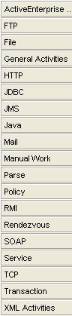
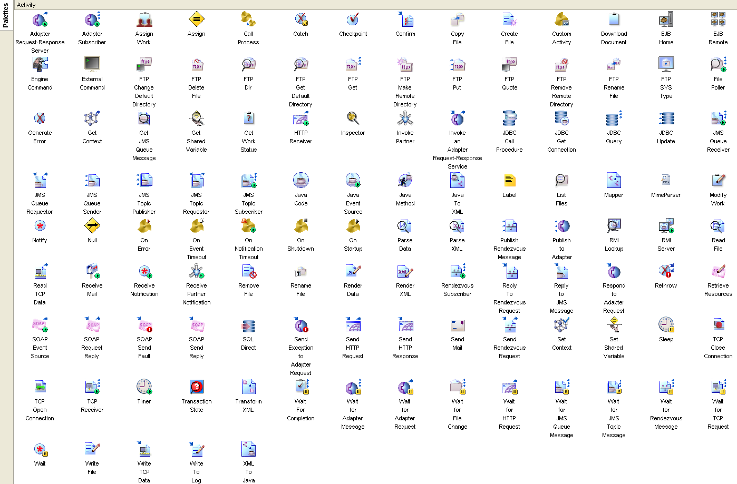
1. Easy Integration
On-Premise
Integration
제공되는 Prebuilt Protocol
Notes:
Yet another capability that differentiates TIBCO CLoud Integration is the independence and flexibility it gives your business across several dimensions
First, you’ll run your integration applications wherever you want, either in the TIBCO Cloud, or in a hybrid environment across on-premesis, containers, public clouds, server less environments, and edge devices.
Second, you’ll consume TIBCO Cloud Integration how you want, with options of the TIBCO managed service or Pay-as-you-Go from public cloud marketplaces with unified billing
And finally, you’ll scale as you want by dynamically scaling peak loads on public cloud infrastructures - helping you adapt your integration needs to your business needs.

Slide 26

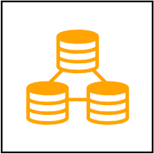
1. Easy Integration
On-Premise
Integration
Adaptive Insights
Adobe Sign
Broadbean
Bullhorn Jobscience
Chargify
cleverbridge
Cvent
Cvent LeadCapture
Docusign
EJB
Epicor
Exact Globe
Exact Synergy
GoToWebinar
Hubspot
IBM Silverpop
iCIMS
InsideView
INXPO
Jira
Magento
Mailchimp
Marketo
Microsoft Dynamics 365
Business Central/NAV
Microsoft Dynamics 365 for
Finance and Operations
Microsoft Dynamics 365 Sales
Microsoft Dynamics CRM
on-premise
Microsoft Dynamics GP
Microsoft Excel
Nodus
OpenGov
Oracle e-Business Suite
Oracle Eloqua
Oracle JD Edwards
Oracle Netsuite
Oracle Peoplesoft
OSISoft PI System
Provance Service Manager
RescoCRM
Sage Intacct
Salesforce Marketing Cloud
Salesforce Pardot
Salesforce Sales
Cloud
Salesforce Service Cloud
SAP NetWeaver
SAP Business Suite
SAP Cloud for
Customer
SAP S/4HANA Cloud
SAP Concur
SAP S4/HANA
On Premise
SAP SuccessFactors
SendGrid
ServiceNow
Shopify
Siebel
SmartMapper
Stripe
SugarCRM
Talkpoint
TIBCO ActiveMatrix BPM
Ultipro
Wordpress
Workday
Xactly Obero SPM
Zendesk
Zoho CRM
Zuora
BUSINESS
APPLICATIONS
Amazon DynamoDB
Amazon Elastic
MapReduce
Amazon RDS for Microsoft
SQL Server
Amazon RDS for MySQL
Amazon RDS for Oracle
Amazon Redshift
Apache Cassandra
Apache CouchDB
Apache Hadoop
Apache HBase
Apache Hive
Apache Pig
Apache Spark
Cloudera CDH
Google Cloud Datastore
Google Cloud SQL
Greenplum Database
Hortonworks
IBM DB2
JDBC
Microsoft Azure SQL
Server
Microsoft Common Data
Service
Microsoft SQL Server
MongoDB
MySQL
Neo4j
ODBC
OLE DB
Oracle Database
PostgreSQL
Redis
RiakKV
SAP HANA Database
Sybase
Teradata
TIBCO Activespaces
TIBCO Clarity
DATABASES & BIG DATA
Notes:
Yet another capability that differentiates TIBCO CLoud Integration is the independence and flexibility it gives your business across several dimensions
First, you’ll run your integration applications wherever you want, either in the TIBCO Cloud, or in a hybrid environment across on-premesis, containers, public clouds, server less environments, and edge devices.
Second, you’ll consume TIBCO Cloud Integration how you want, with options of the TIBCO managed service or Pay-as-you-Go from public cloud marketplaces with unified billing
And finally, you’ll scale as you want by dynamically scaling peak loads on public cloud infrastructures - helping you adapt your integration needs to your business needs.

Slide 27
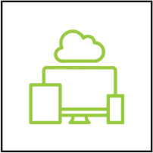

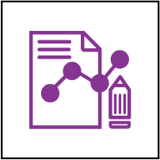

1. Easy Integration
On-Premise
Integration
Amazon EC2
Amazon Elastic File
System
Amazon Glacier
Amazon S3
Box
COBOL data formats
Dropbox
Facebook
GitHub
File
Google Cloud Storage
Google Docs
Google Sheets
Microsoft Azure Storage
Microsoft One Drive
Microsoft SharePoint
Microsoft SharePoint Online
PDF
PL/I data formats
QR Code
RPG data formats
Slack
Text file
Twitter
vCard
XML
FILE FORMATS,
SHARING, & STORAGE
Amazon Kinesis
Amazon SNS
Amazon SQS
Apache ActiveMQ
Apache Kafka
Apache Qpid
IBM CICS
IBM i
IBM Security Directory Server
JMS
LDAP
Microsoft Active Directory
Domain Services
Microsoft Azure Data Factory
Microsoft Active Directory
LightWeight Directory Services
Microsoft Azure Service
Bus
Novell eDirectory
OData
OpenLDAP
Oracle Directory Server
Enterprise
Oracle Internet Directory
Oracle Tuxedo
Push Notifications Android
Push Notifications iOS
RabbitMQ
SWIFT
TIBCO BusinessConnect
TIBCO Cloud Integration
TIBCO Cloud Live Apps
TIBCO Cloud Messaging
TIBCO FTL
TIBCO Managed File
Transfer
TIBCO MDM
TIBCO Scribe Insight
Twilio
INTEGRATION TECHNOLOGIES
Apache Solr
Google Analytics
llodi Decisions
Qlikview
Salesforce Einstein Analytics
TIBCO Cloud AuditSafe
TIBCO Pattern-Search
Trillium
Apache Avro
cXML transactions
eBXML transactions
EDI
Edifact X12
FTP
HIPPA
HL7
HTTP
JSON
Mail (POP3 & SMTP)
MQTT
REST
RosettaNet (RNIF)
sFTP
SMPP
SOAP
TCP
REPORTING & ANALYTICS
INTERFACES & PROTOCOLS
Notes:
Yet another capability that differentiates TIBCO CLoud Integration is the independence and flexibility it gives your business across several dimensions
First, you’ll run your integration applications wherever you want, either in the TIBCO Cloud, or in a hybrid environment across on-premesis, containers, public clouds, server less environments, and edge devices.
Second, you’ll consume TIBCO Cloud Integration how you want, with options of the TIBCO managed service or Pay-as-you-Go from public cloud marketplaces with unified billing
And finally, you’ll scale as you want by dynamically scaling peak loads on public cloud infrastructures - helping you adapt your integration needs to your business needs.

Slide 28
1. Easy Integration
On-Premise
Integration

Slide 29
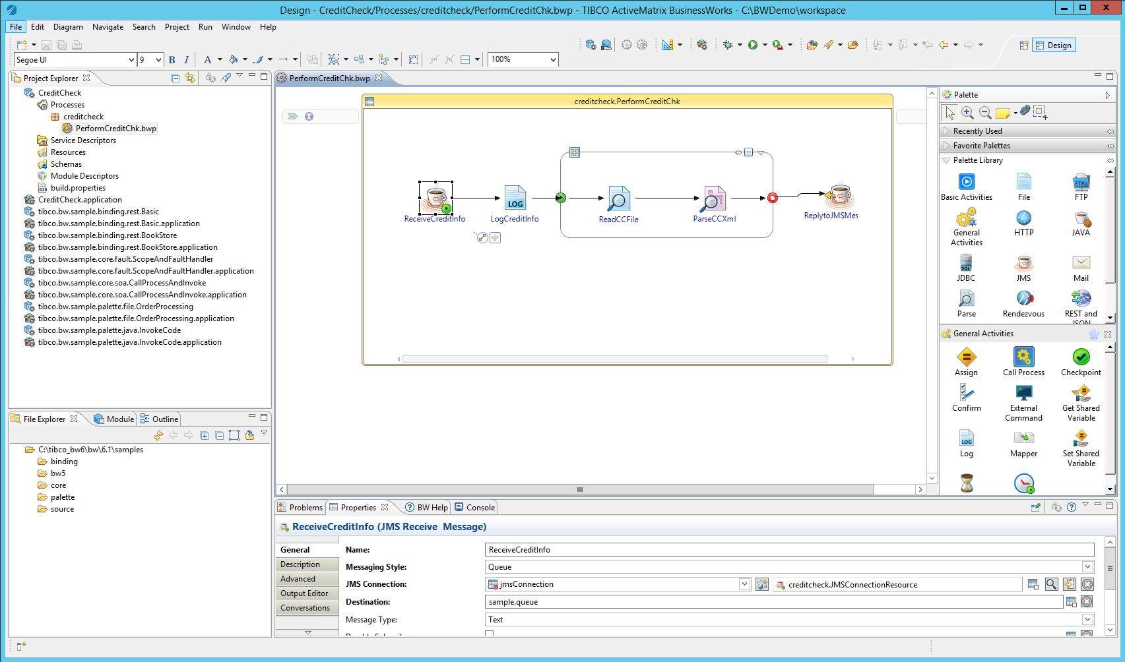
2. Productivity
On-Premise
Integration
Notes:
Yet another capability that differentiates TIBCO CLoud Integration is the independence and flexibility it gives your business across several dimensions
First, you’ll run your integration applications wherever you want, either in the TIBCO Cloud, or in a hybrid environment across on-premesis, containers, public clouds, server less environments, and edge devices.
Second, you’ll consume TIBCO Cloud Integration how you want, with options of the TIBCO managed service or Pay-as-you-Go from public cloud marketplaces with unified billing
And finally, you’ll scale as you want by dynamically scaling peak loads on public cloud infrastructures - helping you adapt your integration needs to your business needs.

Slide 30
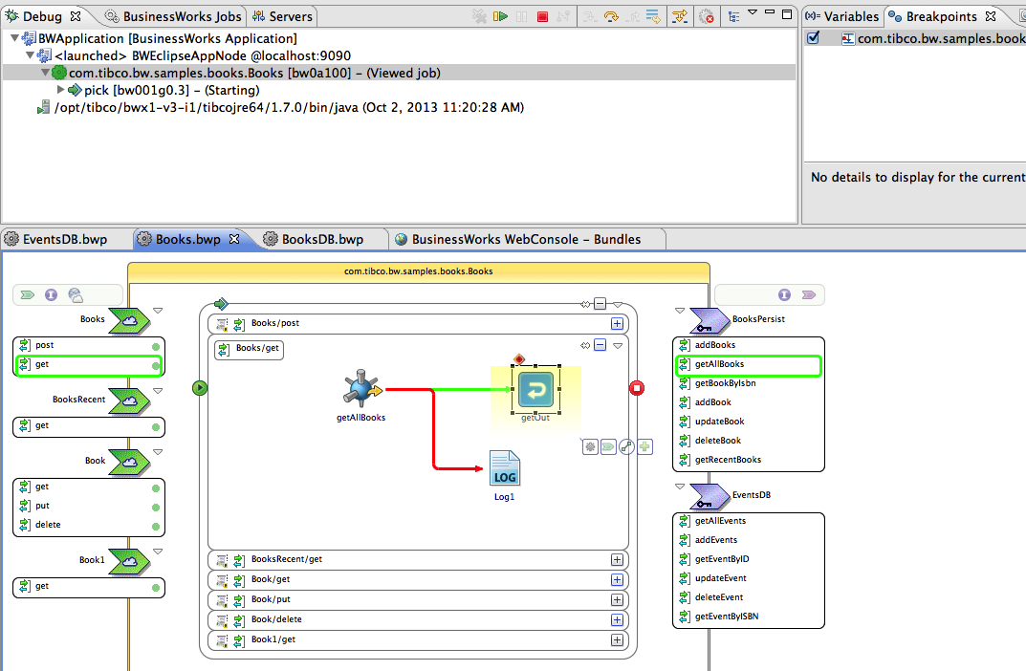
2. Productivity
On-Premise
Integration
Native Eclipse design time
Zero-code integration
Visual Process Debugger
Continuous dev-debug
Notes:
Yet another capability that differentiates TIBCO CLoud Integration is the independence and flexibility it gives your business across several dimensions
First, you’ll run your integration applications wherever you want, either in the TIBCO Cloud, or in a hybrid environment across on-premesis, containers, public clouds, server less environments, and edge devices.
Second, you’ll consume TIBCO Cloud Integration how you want, with options of the TIBCO managed service or Pay-as-you-Go from public cloud marketplaces with unified billing
And finally, you’ll scale as you want by dynamically scaling peak loads on public cloud infrastructures - helping you adapt your integration needs to your business needs.

Slide 31
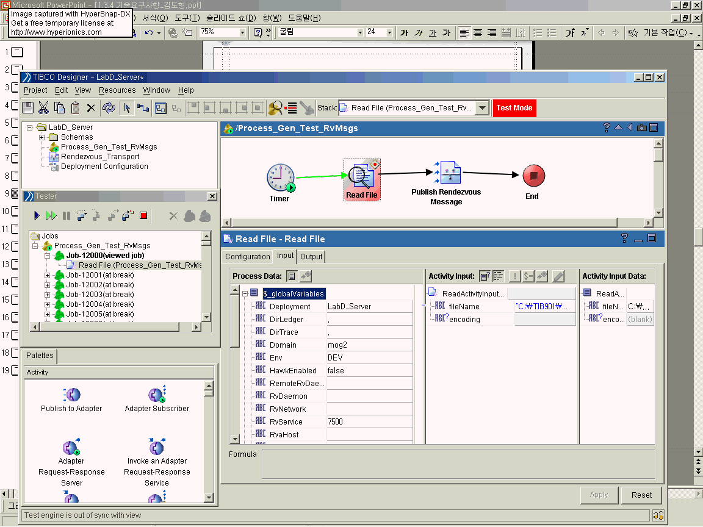
2. Productivity
On-Premise
Integration
테스트 모드
TIBCO Designer 테스트 모드 화면
시뮬레이션 중인
인스턴스 정보
사용된 공용변수, Function 등
을 보여주는 Inspector 기능
TIBCO Designer의 Show Debug Window 메뉴에서 위 그림과 같은 테스트 모드 환경 제공.
자체 디버깅 메뉴를 이용 Transformation, Connection, Communication Component 등을 모두 검증
특정 변수나 function 또는 data item에 Inspector 설정 기능
Breakpoint를 통한 단계적 디버깅 기능 제공
Notes:
Yet another capability that differentiates TIBCO CLoud Integration is the independence and flexibility it gives your business across several dimensions
First, you’ll run your integration applications wherever you want, either in the TIBCO Cloud, or in a hybrid environment across on-premesis, containers, public clouds, server less environments, and edge devices.
Second, you’ll consume TIBCO Cloud Integration how you want, with options of the TIBCO managed service or Pay-as-you-Go from public cloud marketplaces with unified billing
And finally, you’ll scale as you want by dynamically scaling peak loads on public cloud infrastructures - helping you adapt your integration needs to your business needs.

Slide 32

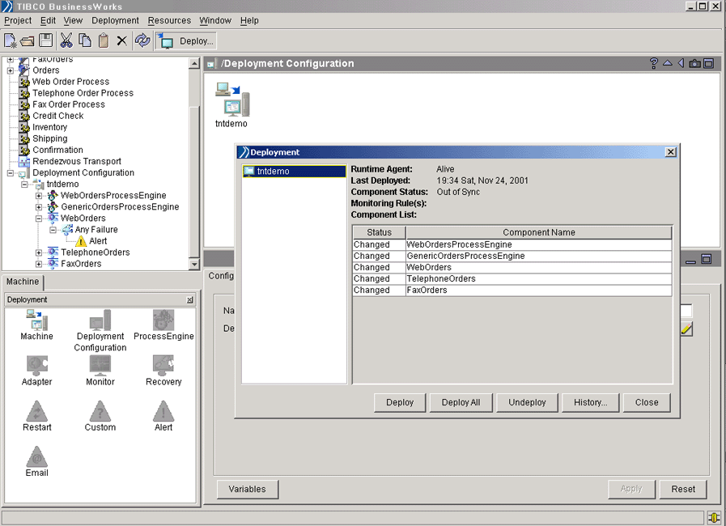
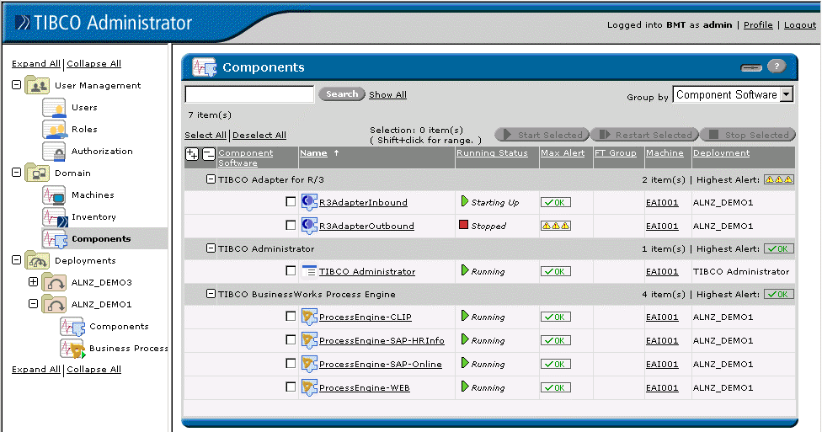
2. Productivity
On-Premise
Integration
설계 (Design)
배포 (Deploy)
관리 (Manage)
TIBCO Designer
TIBCO Administrator
어댑터 구성, 데이터 변환 및 프로세스 설계가 가능한 통합 설계 화면 제공
설계된 프로세스를 런타임 환경으로 배포하기 위한 EAR (Enterprise Archive File) 생성
Deployment
어댑터 및 프로세스 구동
어댑터, 프로세스 모니터링
시스템 및 사용자 관리
Notes:
Yet another capability that differentiates TIBCO CLoud Integration is the independence and flexibility it gives your business across several dimensions
First, you’ll run your integration applications wherever you want, either in the TIBCO Cloud, or in a hybrid environment across on-premesis, containers, public clouds, server less environments, and edge devices.
Second, you’ll consume TIBCO Cloud Integration how you want, with options of the TIBCO managed service or Pay-as-you-Go from public cloud marketplaces with unified billing
And finally, you’ll scale as you want by dynamically scaling peak loads on public cloud infrastructures - helping you adapt your integration needs to your business needs.

Slide 33
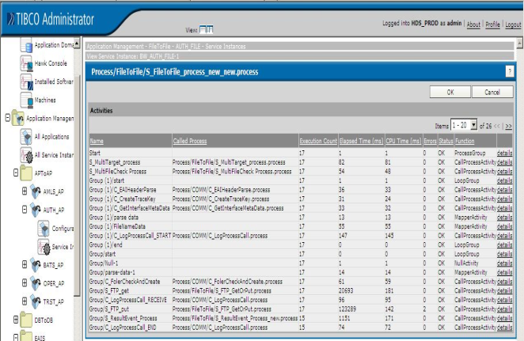
3. Performance
On-Premise
Integration
Active-Active 구성을 통한 Load-Balancing
동적 프로세스 Provisioning
정상거래 시
온라인 거래
폭주 시(주간)
배치 거래
폭주 시(야간)
BW Engine
거래요청
EMS
BW Engine
BW Engine
온라인 거래 그룹
배치 거래 그룹
High Performance Logging Architecture
Profiling을 통한 튜닝
BW
Process
Log File
프로세스의 각 Activity에 대한 통계 정보 제공.
수행건수, 수행시간, CPU Time, Error 건수 등의 정보 제공.
프로세스의 병목구간을 찾아내어 성능개선 및 최적화 함.
DB
Memory Queue
BW
Process
DB
Notes:
Yet another capability that differentiates TIBCO CLoud Integration is the independence and flexibility it gives your business across several dimensions
First, you’ll run your integration applications wherever you want, either in the TIBCO Cloud, or in a hybrid environment across on-premesis, containers, public clouds, server less environments, and edge devices.
Second, you’ll consume TIBCO Cloud Integration how you want, with options of the TIBCO managed service or Pay-as-you-Go from public cloud marketplaces with unified billing
And finally, you’ll scale as you want by dynamically scaling peak loads on public cloud infrastructures - helping you adapt your integration needs to your business needs.

Slide 34
3. Performance
On-Premise
Integration
Source
System
Online Hub
Target
System
고속 메시지 전달
(변환, 라우팅 없음)
AP
A
P
I
A
P
I
AP
MOM (Message Delivery)
EAI (Transform, Routing)
메시지 변환 + 라우팅
AP
A
P
I
MOM (Message Delivery)
A
P
I
AP
AP
Protocol
Adapter
EAI (Transform, Routing)
Protocol
Adapter
AP
메시지 변환 + 라우팅 + 프로토콜 변환
EAI (Transform, Routing)
Protocol
Adapter
AP
Hybrid 방식
AP
A
P
I
MOM (Message Delivery)
Notes:
Yet another capability that differentiates TIBCO CLoud Integration is the independence and flexibility it gives your business across several dimensions
First, you’ll run your integration applications wherever you want, either in the TIBCO Cloud, or in a hybrid environment across on-premesis, containers, public clouds, server less environments, and edge devices.
Second, you’ll consume TIBCO Cloud Integration how you want, with options of the TIBCO managed service or Pay-as-you-Go from public cloud marketplaces with unified billing
And finally, you’ll scale as you want by dynamically scaling peak loads on public cloud infrastructures - helping you adapt your integration needs to your business needs.

Slide 35
3. Performance
On-Premise
Integration
Notes:
Yet another capability that differentiates TIBCO CLoud Integration is the independence and flexibility it gives your business across several dimensions
First, you’ll run your integration applications wherever you want, either in the TIBCO Cloud, or in a hybrid environment across on-premesis, containers, public clouds, server less environments, and edge devices.
Second, you’ll consume TIBCO Cloud Integration how you want, with options of the TIBCO managed service or Pay-as-you-Go from public cloud marketplaces with unified billing
And finally, you’ll scale as you want by dynamically scaling peak loads on public cloud infrastructures - helping you adapt your integration needs to your business needs.

Slide 36
4. Fault Tolerance
On-Premise
Integration
Notes:
Yet another capability that differentiates TIBCO CLoud Integration is the independence and flexibility it gives your business across several dimensions
First, you’ll run your integration applications wherever you want, either in the TIBCO Cloud, or in a hybrid environment across on-premesis, containers, public clouds, server less environments, and edge devices.
Second, you’ll consume TIBCO Cloud Integration how you want, with options of the TIBCO managed service or Pay-as-you-Go from public cloud marketplaces with unified billing
And finally, you’ll scale as you want by dynamically scaling peak loads on public cloud infrastructures - helping you adapt your integration needs to your business needs.

Slide 37
5. Security
On-Premise
Integration
Notes:
Yet another capability that differentiates TIBCO CLoud Integration is the independence and flexibility it gives your business across several dimensions
First, you’ll run your integration applications wherever you want, either in the TIBCO Cloud, or in a hybrid environment across on-premesis, containers, public clouds, server less environments, and edge devices.
Second, you’ll consume TIBCO Cloud Integration how you want, with options of the TIBCO managed service or Pay-as-you-Go from public cloud marketplaces with unified billing
And finally, you’ll scale as you want by dynamically scaling peak loads on public cloud infrastructures - helping you adapt your integration needs to your business needs.

Slide 38
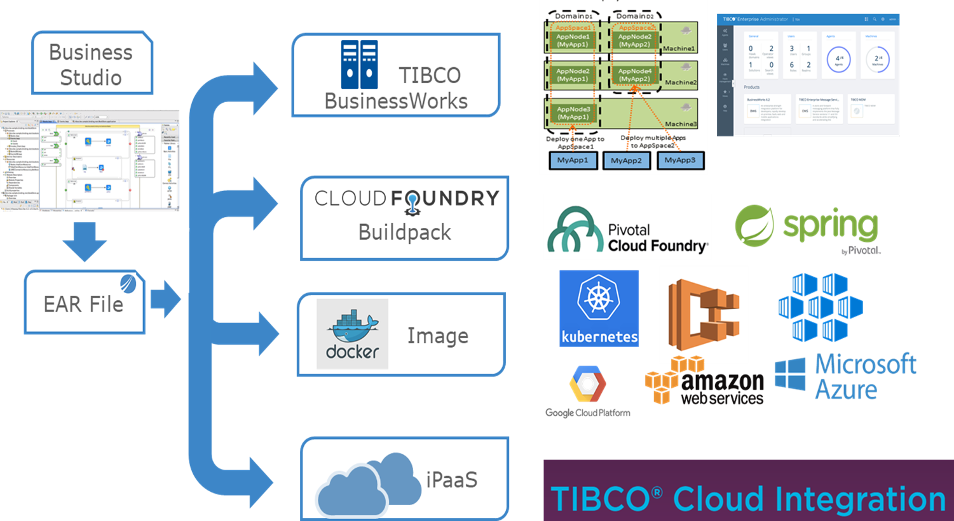
One More Thing…
On-Premise
Integration
Notes:
Yet another capability that differentiates TIBCO CLoud Integration is the independence and flexibility it gives your business across several dimensions
First, you’ll run your integration applications wherever you want, either in the TIBCO Cloud, or in a hybrid environment across on-premesis, containers, public clouds, server less environments, and edge devices.
Second, you’ll consume TIBCO Cloud Integration how you want, with options of the TIBCO managed service or Pay-as-you-Go from public cloud marketplaces with unified billing
And finally, you’ll scale as you want by dynamically scaling peak loads on public cloud infrastructures - helping you adapt your integration needs to your business needs.

Slide 39
2. Cloud Integration
Legacy
Legacy
Legacy
Cloud Integration
Legacy
Shared Data Assets
Legacy
Legacy
Notes:
Yet another capability that differentiates TIBCO CLoud Integration is the independence and flexibility it gives your business across several dimensions
First, you’ll run your integration applications wherever you want, either in the TIBCO Cloud, or in a hybrid environment across on-premesis, containers, public clouds, server less environments, and edge devices.
Second, you’ll consume TIBCO Cloud Integration how you want, with options of the TIBCO managed service or Pay-as-you-Go from public cloud marketplaces with unified billing
And finally, you’ll scale as you want by dynamically scaling peak loads on public cloud infrastructures - helping you adapt your integration needs to your business needs.

Slide 40
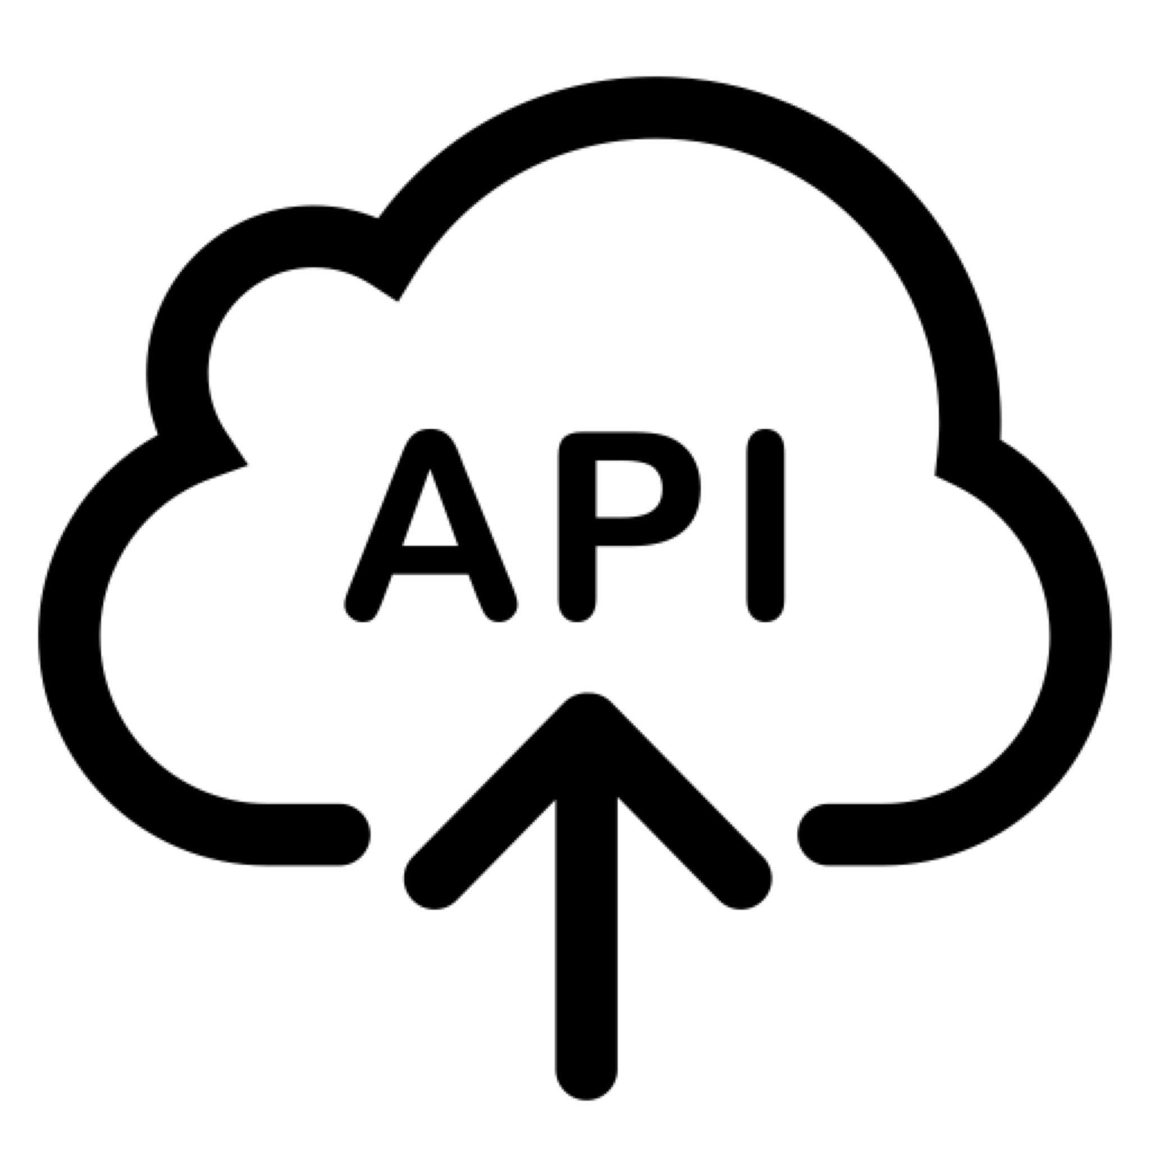
Concept
Cloud
Integration
BusinessWorks
Mashery
Deploy
Process (from Workday)
Process (to Legacy)
RDBMS
Plug-in
XML
Plug-in
XML
ERP
Plug-in
Workday
Plug-in
from Workday
TCP/IP
Plug-in
XML
Data
Data
Legacy HR
Messaging (Workday → Legacy)
to Legacy
ERP
EMS
Messaging (Legacy → Workday)
RDBMS
Data
Data
Data
RDBMS
Plug-in
to Workday
File
Process (from Legacy)
Process (to Workday)
XML
Plug-in
ERP
Plug-in
J2EE
Workday
Plug-in
Data
TCP/IP
Plug-in
Deploy
from Legacy
WAS
BusinessWorks
Notes:
Yet another capability that differentiates TIBCO CLoud Integration is the independence and flexibility it gives your business across several dimensions
First, you’ll run your integration applications wherever you want, either in the TIBCO Cloud, or in a hybrid environment across on-premesis, containers, public clouds, server less environments, and edge devices.
Second, you’ll consume TIBCO Cloud Integration how you want, with options of the TIBCO managed service or Pay-as-you-Go from public cloud marketplaces with unified billing
And finally, you’ll scale as you want by dynamically scaling peak loads on public cloud infrastructures - helping you adapt your integration needs to your business needs.

Slide 41
Operation
Cloud
Integration
Mashery Local
API
호출 시스템
Local Cache
API Config
내부 API
제공 시스템
無 변경
1
Traffic Manager
(routing/throttling/logging/...)
API 호출
요청 수신
API 응답 대기
2
3
요청 처리
5
6
API Mediator (BW6)
(orchestration/transform/integration/…)
API 응답 수신
응답 송신
4
요청 flow
응답 flow
Notes:
Yet another capability that differentiates TIBCO CLoud Integration is the independence and flexibility it gives your business across several dimensions
First, you’ll run your integration applications wherever you want, either in the TIBCO Cloud, or in a hybrid environment across on-premesis, containers, public clouds, server less environments, and edge devices.
Second, you’ll consume TIBCO Cloud Integration how you want, with options of the TIBCO managed service or Pay-as-you-Go from public cloud marketplaces with unified billing
And finally, you’ll scale as you want by dynamically scaling peak loads on public cloud infrastructures - helping you adapt your integration needs to your business needs.

Slide 42
Things to Consider
Cloud
Integration
Data Consistency : Workday-Legacy 데이터 정합성
Productivity : EAI와 API G/W 연계
Performance : API 환경을 고려한 성능 확보
API Governance : 다수의 API 배포, 모니터링, 정책
Security : 사용자 및 그룹 별 접근제어
Notes:
Yet another capability that differentiates TIBCO CLoud Integration is the independence and flexibility it gives your business across several dimensions
First, you’ll run your integration applications wherever you want, either in the TIBCO Cloud, or in a hybrid environment across on-premesis, containers, public clouds, server less environments, and edge devices.
Second, you’ll consume TIBCO Cloud Integration how you want, with options of the TIBCO managed service or Pay-as-you-Go from public cloud marketplaces with unified billing
And finally, you’ll scale as you want by dynamically scaling peak loads on public cloud infrastructures - helping you adapt your integration needs to your business needs.

Slide 43


1. Data Consistency
Cloud
Integration
Legacy HR
EMS Client
TIBCO EMS Server
EMS Client
Message Provider
Queues
Message Consumer
Send Message
Receive Message
Durable Topics
Confirmation
Acknowledge
File Disk
Notes:
Yet another capability that differentiates TIBCO CLoud Integration is the independence and flexibility it gives your business across several dimensions
First, you’ll run your integration applications wherever you want, either in the TIBCO Cloud, or in a hybrid environment across on-premesis, containers, public clouds, server less environments, and edge devices.
Second, you’ll consume TIBCO Cloud Integration how you want, with options of the TIBCO managed service or Pay-as-you-Go from public cloud marketplaces with unified billing
And finally, you’ll scale as you want by dynamically scaling peak loads on public cloud infrastructures - helping you adapt your integration needs to your business needs.

Slide 44
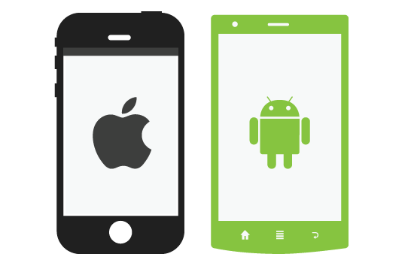

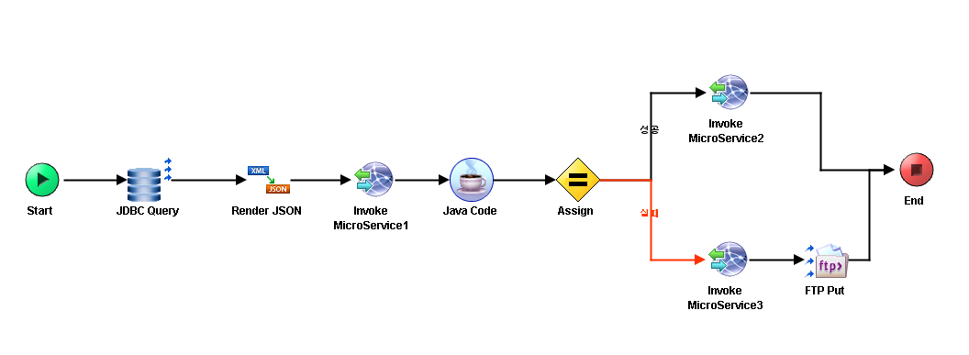
1. Data Consistency
Cloud
Integration
Mediation
복수개의 백엔드 서비스를 원하는 플로우와 조건으로 조합하여 새로운 서비스로 구성
다양한 프로토콜(JDBC, SAP, JMS, FILE 등)의 레거시 시스템과 백엔드 서비스를 결합하여 연동
처리 실패 건에 대한 재처리 수행 (업무 요건)
Multi Backend-Services Orchestration
API 호출
Traffic Manager
API
Mediator
Business Services
Business Services
Business Services
Business Services
Business Services
Business Services
< TIBCO BusinessWorks Process 예시>
Notes:
Yet another capability that differentiates TIBCO CLoud Integration is the independence and flexibility it gives your business across several dimensions
First, you’ll run your integration applications wherever you want, either in the TIBCO Cloud, or in a hybrid environment across on-premesis, containers, public clouds, server less environments, and edge devices.
Second, you’ll consume TIBCO Cloud Integration how you want, with options of the TIBCO managed service or Pay-as-you-Go from public cloud marketplaces with unified billing
And finally, you’ll scale as you want by dynamically scaling peak loads on public cloud infrastructures - helping you adapt your integration needs to your business needs.

Slide 45
1. Data Consistency
Cloud
Integration
Notes:
Yet another capability that differentiates TIBCO CLoud Integration is the independence and flexibility it gives your business across several dimensions
First, you’ll run your integration applications wherever you want, either in the TIBCO Cloud, or in a hybrid environment across on-premesis, containers, public clouds, server less environments, and edge devices.
Second, you’ll consume TIBCO Cloud Integration how you want, with options of the TIBCO managed service or Pay-as-you-Go from public cloud marketplaces with unified billing
And finally, you’ll scale as you want by dynamically scaling peak loads on public cloud infrastructures - helping you adapt your integration needs to your business needs.

Slide 46
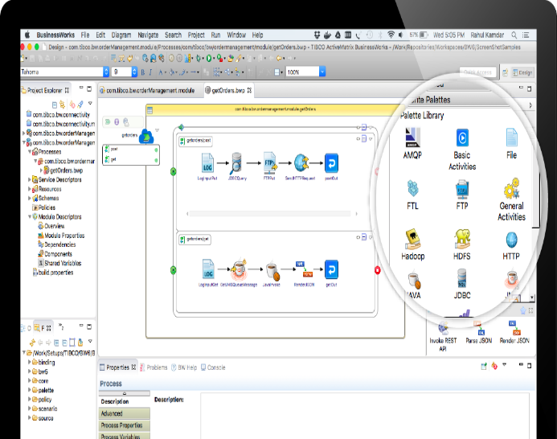
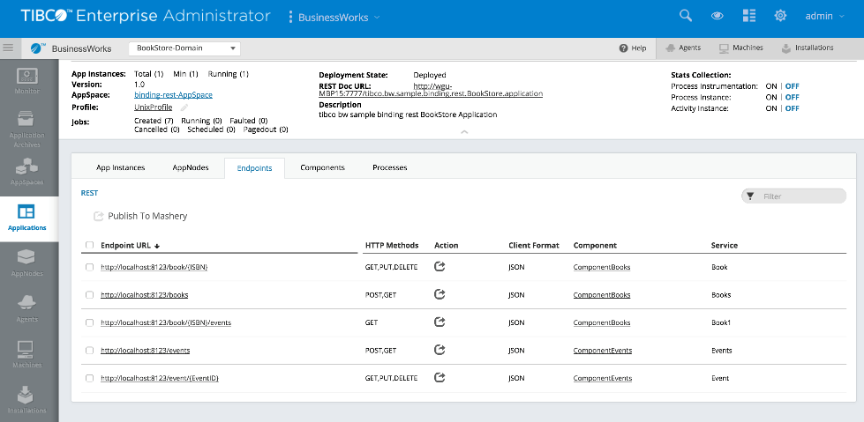
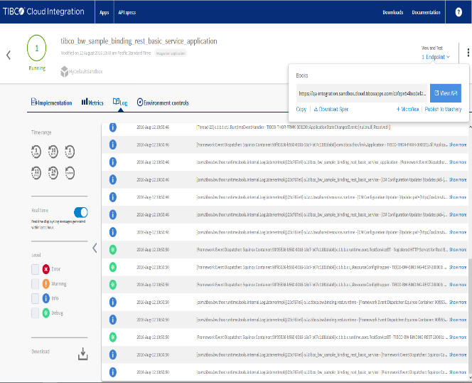

2. Productivity
Cloud
Integration
BW6에서 REST API 개발,테스트
Administrator에서 Mashery 배포
Machery에서 API 운영,관리
API에 대한 개발, 테스트, 배포, 운영 관리에 대한 자동화된 서비스를 제공
Notes:
Yet another capability that differentiates TIBCO CLoud Integration is the independence and flexibility it gives your business across several dimensions
First, you’ll run your integration applications wherever you want, either in the TIBCO Cloud, or in a hybrid environment across on-premesis, containers, public clouds, server less environments, and edge devices.
Second, you’ll consume TIBCO Cloud Integration how you want, with options of the TIBCO managed service or Pay-as-you-Go from public cloud marketplaces with unified billing
And finally, you’ll scale as you want by dynamically scaling peak loads on public cloud infrastructures - helping you adapt your integration needs to your business needs.

Slide 47
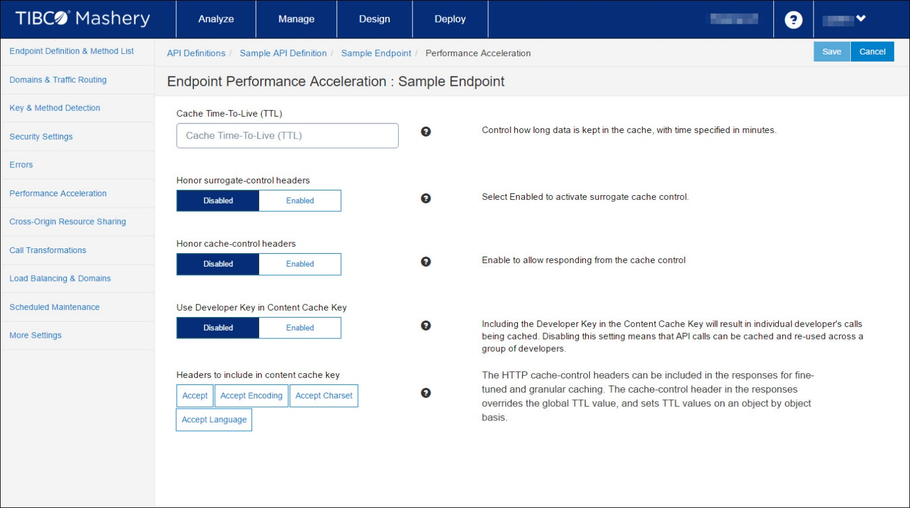
3. Performance
Cloud
Integration
Accelerator Field | Description
Cache Time-To-Live (TTL) | Data(Resource)를 Cache에 보관할 시간(분, Minutes)
Use Developer Key in Content Cache Key | 컨텐츠 Cache Key에 개발자 전용 Key를 포함시켜, Runtime에 Debugging이 가능하도록 구성
Respond From Cache Control Enabled | Cache Control로 부터 응답 처리를 수행
Client Surrogate Control | Traffics Manager가 Cache-Control의 지정 TTL값이 아닌 Surrogate-Control에 지정된 TTL로 제어를 할 수 있도록 설정
Content Cache Key Headers | Caching 된 데이터 포함시킬 수 있는 Response Header 항목 Accept : MIME Type Accept-Encoding : Compression Algorithm Accept-Charset : Character Set Accept-Language : Natural Language
Notes:
Yet another capability that differentiates TIBCO CLoud Integration is the independence and flexibility it gives your business across several dimensions
First, you’ll run your integration applications wherever you want, either in the TIBCO Cloud, or in a hybrid environment across on-premesis, containers, public clouds, server less environments, and edge devices.
Second, you’ll consume TIBCO Cloud Integration how you want, with options of the TIBCO managed service or Pay-as-you-Go from public cloud marketplaces with unified billing
And finally, you’ll scale as you want by dynamically scaling peak loads on public cloud infrastructures - helping you adapt your integration needs to your business needs.

Slide 48

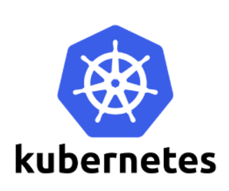
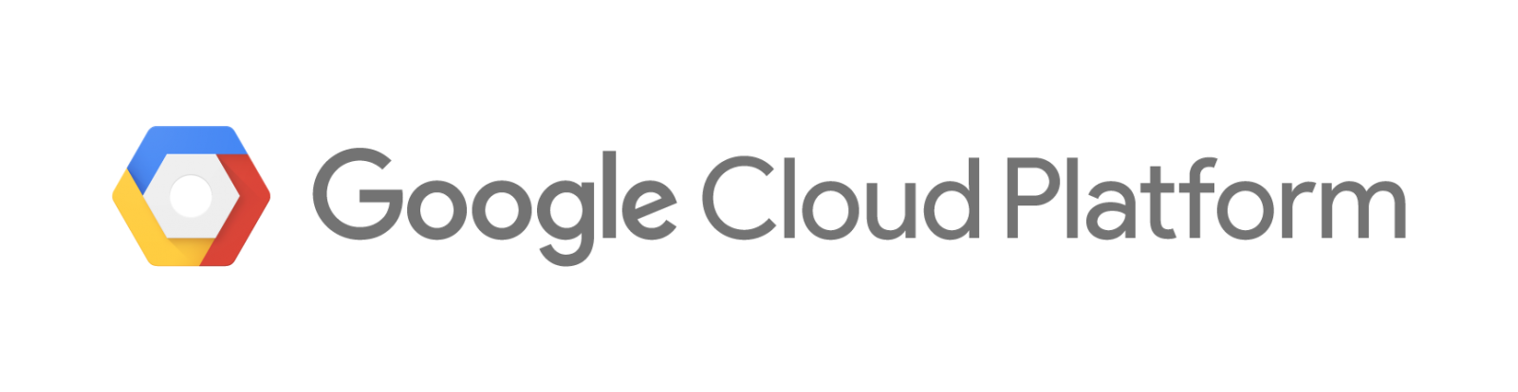

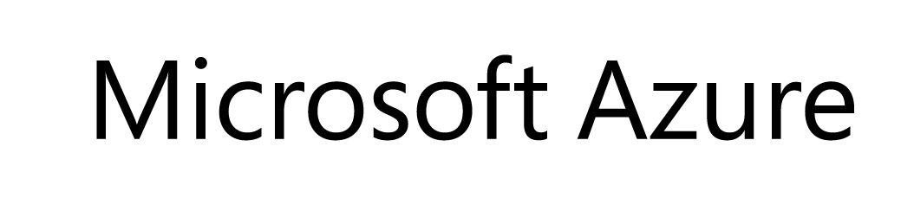
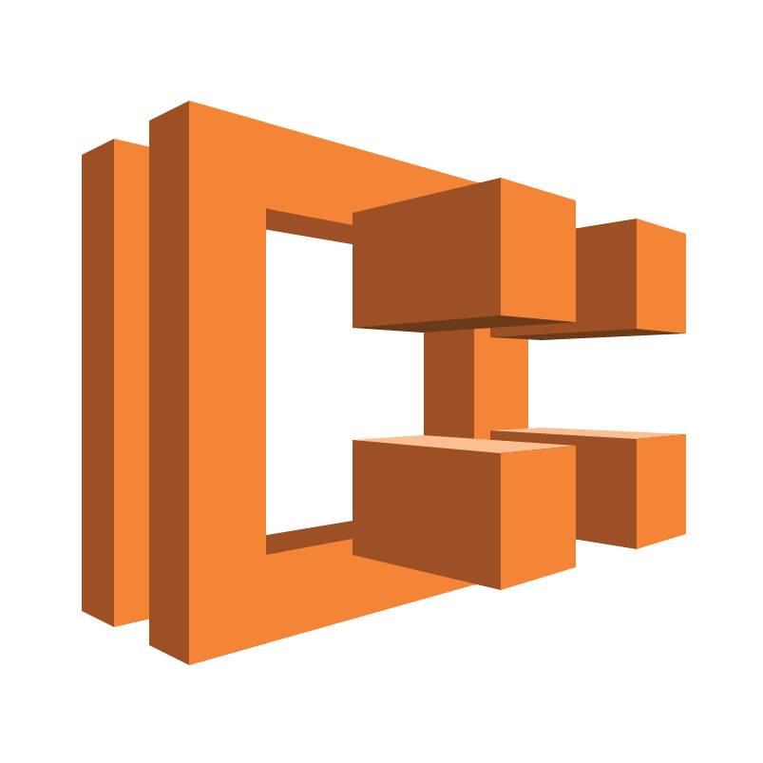
4. API Governance
Cloud
Integration
APIs
APIs
APIs
APIs
APIs
APIs
APIs
API Gateway and Management
APIs
Security
Aggregation of APIS
APIs
Developer & Partner Portal
Analytics
Monetization
On – Premise Application
Notes:
Yet another capability that differentiates TIBCO CLoud Integration is the independence and flexibility it gives your business across several dimensions
First, you’ll run your integration applications wherever you want, either in the TIBCO Cloud, or in a hybrid environment across on-premesis, containers, public clouds, server less environments, and edge devices.
Second, you’ll consume TIBCO Cloud Integration how you want, with options of the TIBCO managed service or Pay-as-you-Go from public cloud marketplaces with unified billing
And finally, you’ll scale as you want by dynamically scaling peak loads on public cloud infrastructures - helping you adapt your integration needs to your business needs.

Slide 49
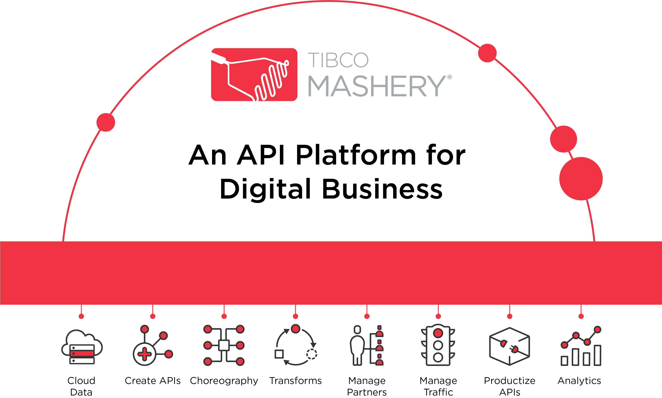
4. API Governance
Cloud
Integration
Notes:
Yet another capability that differentiates TIBCO CLoud Integration is the independence and flexibility it gives your business across several dimensions
First, you’ll run your integration applications wherever you want, either in the TIBCO Cloud, or in a hybrid environment across on-premesis, containers, public clouds, server less environments, and edge devices.
Second, you’ll consume TIBCO Cloud Integration how you want, with options of the TIBCO managed service or Pay-as-you-Go from public cloud marketplaces with unified billing
And finally, you’ll scale as you want by dynamically scaling peak loads on public cloud infrastructures - helping you adapt your integration needs to your business needs.

Slide 50





4. API Governance
Cloud
Integration
PARTNER PORTAL
TRAFFIC MANAGER
API DISTRIBUTION NETWORK™
REPORTING & ANALYTICS
Discover APIs
-------------------- Distribute APIs --------------------
Engage
Control
Perform
Measure
Get API consumers signed up and building fast, scale developer support
Define access & security policies, manage API packages
Ensure fast, reliable API performance—in the cloud, on-prem, or both
Understand how your platform drives real business value and optimize API usage
Notes:
Yet another capability that differentiates TIBCO CLoud Integration is the independence and flexibility it gives your business across several dimensions
First, you’ll run your integration applications wherever you want, either in the TIBCO Cloud, or in a hybrid environment across on-premesis, containers, public clouds, server less environments, and edge devices.
Second, you’ll consume TIBCO Cloud Integration how you want, with options of the TIBCO managed service or Pay-as-you-Go from public cloud marketplaces with unified billing
And finally, you’ll scale as you want by dynamically scaling peak loads on public cloud infrastructures - helping you adapt your integration needs to your business needs.

Slide 51
5. Security
Cloud
Integration
Notes:
Yet another capability that differentiates TIBCO CLoud Integration is the independence and flexibility it gives your business across several dimensions
First, you’ll run your integration applications wherever you want, either in the TIBCO Cloud, or in a hybrid environment across on-premesis, containers, public clouds, server less environments, and edge devices.
Second, you’ll consume TIBCO Cloud Integration how you want, with options of the TIBCO managed service or Pay-as-you-Go from public cloud marketplaces with unified billing
And finally, you’ll scale as you want by dynamically scaling peak loads on public cloud infrastructures - helping you adapt your integration needs to your business needs.

Slide 52




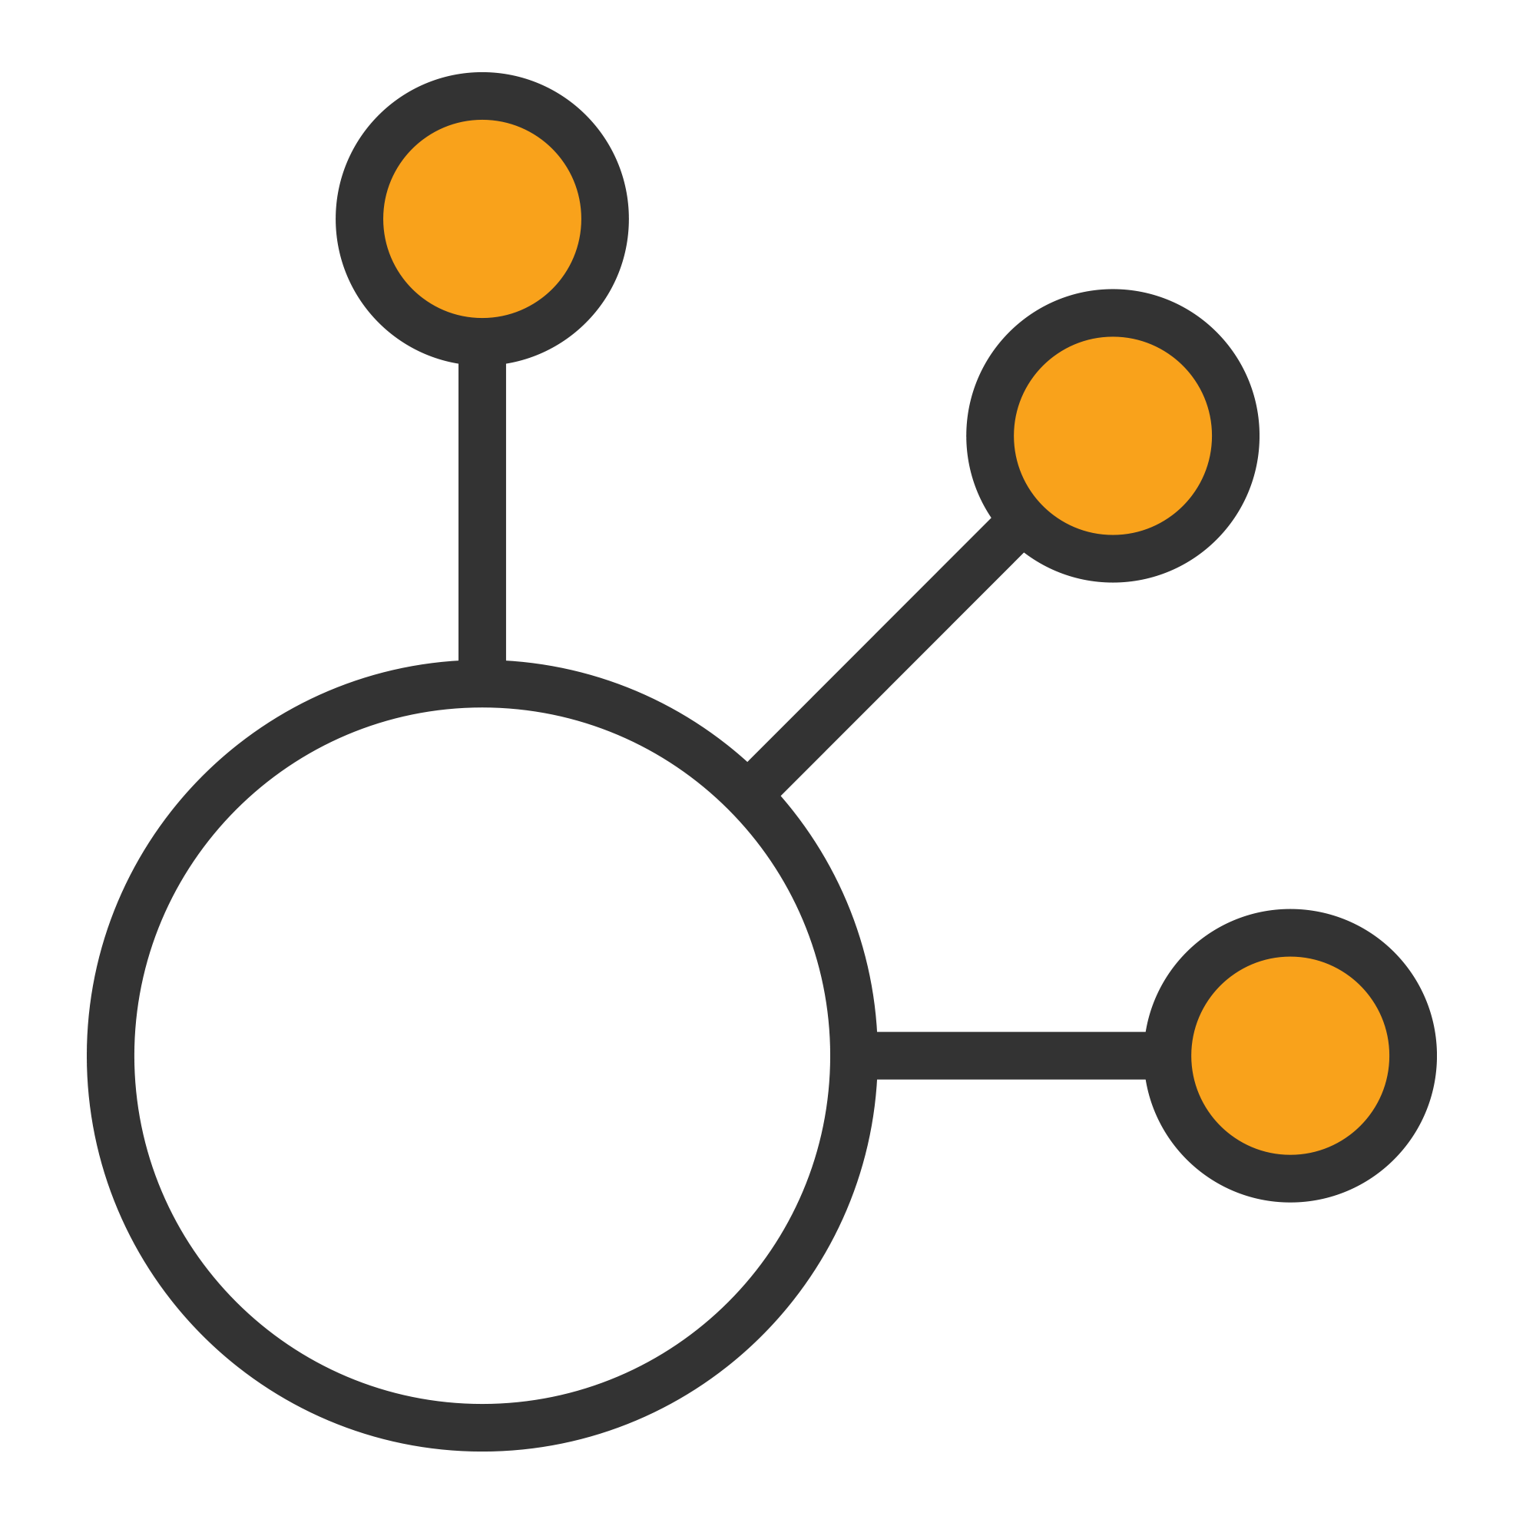



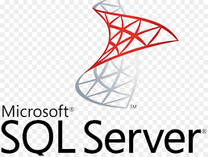

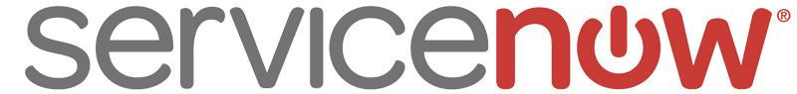



One More Thing…
Cloud
Integration
Digital Interface
B2B Interface
Internal & External API Catalogue
Standard, secure interface for service consumption
APIs are secured and governed
API Platform
API
API
API
API
API
API
API
API
API
API
API
API
API
API
API
Interface doesn’t change as services are updated
Shipping Microservices
Customer Microservices
Payment Microservices
Order Microservices
Inventory Microservices
API
API
API
API
API
API
Complexity of systems are abstracted
IoT

Slide 53
One More Thing…
Cloud
Integration
Notes:
Yet another capability that differentiates TIBCO CLoud Integration is the independence and flexibility it gives your business across several dimensions
First, you’ll run your integration applications wherever you want, either in the TIBCO Cloud, or in a hybrid environment across on-premesis, containers, public clouds, server less environments, and edge devices.
Second, you’ll consume TIBCO Cloud Integration how you want, with options of the TIBCO managed service or Pay-as-you-Go from public cloud marketplaces with unified billing
And finally, you’ll scale as you want by dynamically scaling peak loads on public cloud infrastructures - helping you adapt your integration needs to your business needs.

Slide 54
3. Workday Integration
Legacy
Legacy
Legacy
Workday Integration
Legacy
Shared Data Assets
Legacy
Legacy
Notes:
Yet another capability that differentiates TIBCO CLoud Integration is the independence and flexibility it gives your business across several dimensions
First, you’ll run your integration applications wherever you want, either in the TIBCO Cloud, or in a hybrid environment across on-premesis, containers, public clouds, server less environments, and edge devices.
Second, you’ll consume TIBCO Cloud Integration how you want, with options of the TIBCO managed service or Pay-as-you-Go from public cloud marketplaces with unified billing
And finally, you’ll scale as you want by dynamically scaling peak loads on public cloud infrastructures - helping you adapt your integration needs to your business needs.

Slide 55
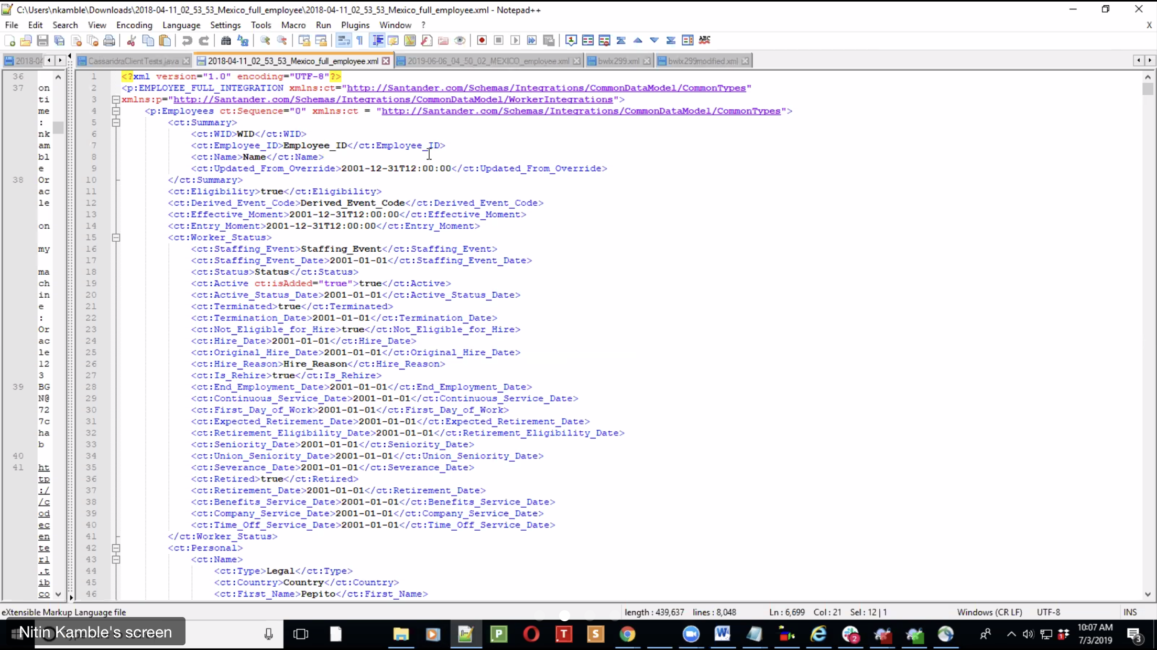
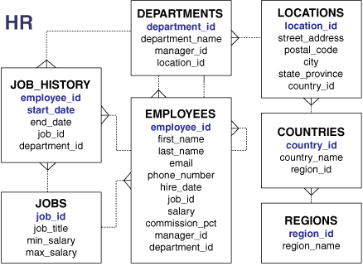
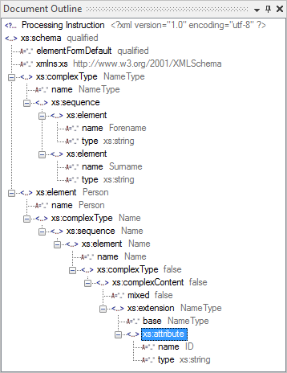
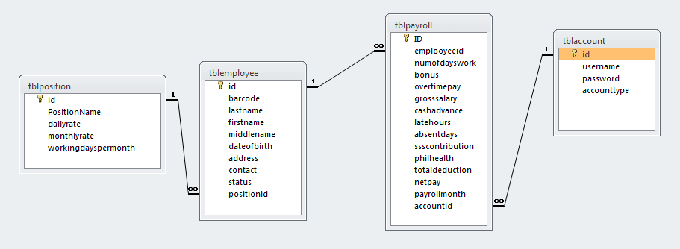
Concept
Workday
Integration
Legacy HR
XML - RDBMS (JDBC)
Human
Resources
XML - RDBMS (JDBC)
Staffing
XML - XML (sFTP)
XML - WAS (HTTP)
Payroll
Notes:
Yet another capability that differentiates TIBCO CLoud Integration is the independence and flexibility it gives your business across several dimensions
First, you’ll run your integration applications wherever you want, either in the TIBCO Cloud, or in a hybrid environment across on-premesis, containers, public clouds, server less environments, and edge devices.
Second, you’ll consume TIBCO Cloud Integration how you want, with options of the TIBCO managed service or Pay-as-you-Go from public cloud marketplaces with unified billing
And finally, you’ll scale as you want by dynamically scaling peak loads on public cloud infrastructures - helping you adapt your integration needs to your business needs.

Slide 56
Concept
Workday
Integration
BusinessWorks
Legacy HR
Staffing
Payroll
Human
Resources
Downward Process
ERP
RDBMS
Plug-in
sFTP
Plug-in
Ingest
Mapping
Transform
Write
XML
Plug-in
RDBMS
Workday
Plug-in
TCP/IP
Plug-in
XML
File
Upward Process
RDBMS
Plug-in
J2EE
sFTP
Plug-in
Upload
Transform
Mapping
Ingest
XML
Plug-in
Workday
Plug-in
WAS
TCP/IP
Plug-in
Notes:
Yet another capability that differentiates TIBCO CLoud Integration is the independence and flexibility it gives your business across several dimensions
First, you’ll run your integration applications wherever you want, either in the TIBCO Cloud, or in a hybrid environment across on-premesis, containers, public clouds, server less environments, and edge devices.
Second, you’ll consume TIBCO Cloud Integration how you want, with options of the TIBCO managed service or Pay-as-you-Go from public cloud marketplaces with unified billing
And finally, you’ll scale as you want by dynamically scaling peak loads on public cloud infrastructures - helping you adapt your integration needs to your business needs.

Slide 57
Things to Consider
Workday
Integration
Easy Integration : OOTB Workday 연계 지원
Usability : 실용성을 고려한 통합
Experience : Workday 통합 경험
Notes:
Yet another capability that differentiates TIBCO CLoud Integration is the independence and flexibility it gives your business across several dimensions
First, you’ll run your integration applications wherever you want, either in the TIBCO Cloud, or in a hybrid environment across on-premesis, containers, public clouds, server less environments, and edge devices.
Second, you’ll consume TIBCO Cloud Integration how you want, with options of the TIBCO managed service or Pay-as-you-Go from public cloud marketplaces with unified billing
And finally, you’ll scale as you want by dynamically scaling peak loads on public cloud infrastructures - helping you adapt your integration needs to your business needs.

Slide 58
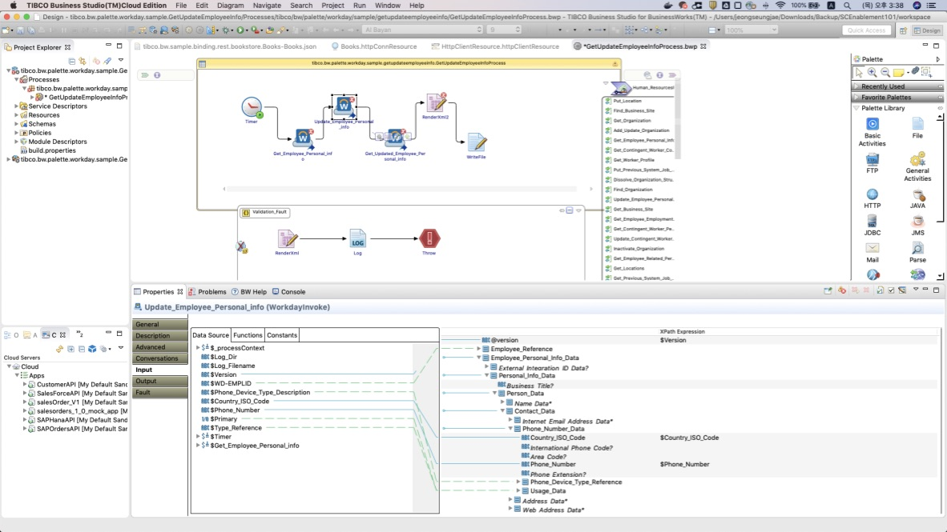
1. Easy Integration
Workday
Integration
Notes:
Yet another capability that differentiates TIBCO CLoud Integration is the independence and flexibility it gives your business across several dimensions
First, you’ll run your integration applications wherever you want, either in the TIBCO Cloud, or in a hybrid environment across on-premesis, containers, public clouds, server less environments, and edge devices.
Second, you’ll consume TIBCO Cloud Integration how you want, with options of the TIBCO managed service or Pay-as-you-Go from public cloud marketplaces with unified billing
And finally, you’ll scale as you want by dynamically scaling peak loads on public cloud infrastructures - helping you adapt your integration needs to your business needs.

Slide 59
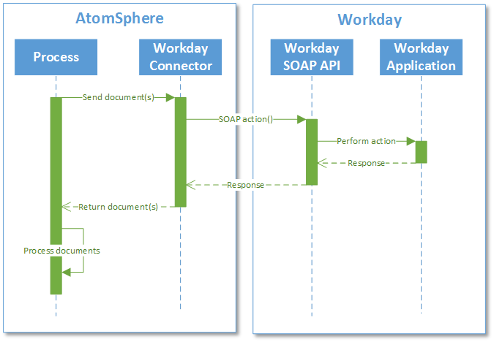
1. Easy Integration
Workday
Integration
BusinessWorks
Drag-and-Drop
No coding required
No need to build SOAP client
Easy input-output mapping
Notes:
Yet another capability that differentiates TIBCO CLoud Integration is the independence and flexibility it gives your business across several dimensions
First, you’ll run your integration applications wherever you want, either in the TIBCO Cloud, or in a hybrid environment across on-premesis, containers, public clouds, server less environments, and edge devices.
Second, you’ll consume TIBCO Cloud Integration how you want, with options of the TIBCO managed service or Pay-as-you-Go from public cloud marketplaces with unified billing
And finally, you’ll scale as you want by dynamically scaling peak loads on public cloud infrastructures - helping you adapt your integration needs to your business needs.

Slide 60
2. Usability
Workday
Integration
Large XML Plug-in
Efficient memory usage
Fast parsing and processing
Fast batch processing
Easy data sharing
Notes:
Yet another capability that differentiates TIBCO CLoud Integration is the independence and flexibility it gives your business across several dimensions
First, you’ll run your integration applications wherever you want, either in the TIBCO Cloud, or in a hybrid environment across on-premesis, containers, public clouds, server less environments, and edge devices.
Second, you’ll consume TIBCO Cloud Integration how you want, with options of the TIBCO managed service or Pay-as-you-Go from public cloud marketplaces with unified billing
And finally, you’ll scale as you want by dynamically scaling peak loads on public cloud infrastructures - helping you adapt your integration needs to your business needs.

Slide 61




3. Experience
Workday
Integration
Country A
BWCE
Legacy
EMS
Global I/F
Local
I/F (A)
Large
XML (A)
Message (A)
M
O
M
XML (2GB+)
via sFTP
Private Cloud
Country B
BWCE
Legacy
XML (2GB+)
via sFTP
EMS
Global I/F
Local
I/F (B)
Large
XML (B)
Message (B)
M
O
M
Private Cloud
Notes:
Yet another capability that differentiates TIBCO CLoud Integration is the independence and flexibility it gives your business across several dimensions
First, you’ll run your integration applications wherever you want, either in the TIBCO Cloud, or in a hybrid environment across on-premesis, containers, public clouds, server less environments, and edge devices.
Second, you’ll consume TIBCO Cloud Integration how you want, with options of the TIBCO managed service or Pay-as-you-Go from public cloud marketplaces with unified billing
And finally, you’ll scale as you want by dynamically scaling peak loads on public cloud infrastructures - helping you adapt your integration needs to your business needs.

Slide 62

3. Experience
Workday
Integration
Notes:
Yet another capability that differentiates TIBCO CLoud Integration is the independence and flexibility it gives your business across several dimensions
First, you’ll run your integration applications wherever you want, either in the TIBCO Cloud, or in a hybrid environment across on-premesis, containers, public clouds, server less environments, and edge devices.
Second, you’ll consume TIBCO Cloud Integration how you want, with options of the TIBCO managed service or Pay-as-you-Go from public cloud marketplaces with unified billing
And finally, you’ll scale as you want by dynamically scaling peak loads on public cloud infrastructures - helping you adapt your integration needs to your business needs.

Slide 63

3. Experience
Workday
Integration
Notes:
Yet another capability that differentiates TIBCO CLoud Integration is the independence and flexibility it gives your business across several dimensions
First, you’ll run your integration applications wherever you want, either in the TIBCO Cloud, or in a hybrid environment across on-premesis, containers, public clouds, server less environments, and edge devices.
Second, you’ll consume TIBCO Cloud Integration how you want, with options of the TIBCO managed service or Pay-as-you-Go from public cloud marketplaces with unified billing
And finally, you’ll scale as you want by dynamically scaling peak loads on public cloud infrastructures - helping you adapt your integration needs to your business needs.

Slide 64
Wrap-up

Slide 65
Hybrid Integration
Legacy
On-Premise Integration
Legacy
Legacy
Cloud Integration
Workday Integration
Legacy
Shared Data Assets
Legacy
Legacy
Notes:
Yet another capability that differentiates TIBCO CLoud Integration is the independence and flexibility it gives your business across several dimensions
First, you’ll run your integration applications wherever you want, either in the TIBCO Cloud, or in a hybrid environment across on-premesis, containers, public clouds, server less environments, and edge devices.
Second, you’ll consume TIBCO Cloud Integration how you want, with options of the TIBCO managed service or Pay-as-you-Go from public cloud marketplaces with unified billing
And finally, you’ll scale as you want by dynamically scaling peak loads on public cloud infrastructures - helping you adapt your integration needs to your business needs.

Slide 66
1. On-premise Integration
On-Premise
Integration
Easy Integration : 750+ pre-built plug-in
Productivity : GUI-based zero-coding environment
Performance : Scalable multi-node architecture
Fault Tolerance : Fail-safe HA architecture
Security : Full ACL + message encryption
Notes:
Yet another capability that differentiates TIBCO CLoud Integration is the independence and flexibility it gives your business across several dimensions
First, you’ll run your integration applications wherever you want, either in the TIBCO Cloud, or in a hybrid environment across on-premesis, containers, public clouds, server less environments, and edge devices.
Second, you’ll consume TIBCO Cloud Integration how you want, with options of the TIBCO managed service or Pay-as-you-Go from public cloud marketplaces with unified billing
And finally, you’ll scale as you want by dynamically scaling peak loads on public cloud infrastructures - helping you adapt your integration needs to your business needs.

Slide 67
2. Cloud Integration
Cloud
Integration
Data Consistency : Safe message transfer guaranteed
Productivity : Seamless process-to-API deployment
Performance : API performance acceleration
API Governance : Easy API deployment and monitoring
Security : User and group level ACL
Notes:
Yet another capability that differentiates TIBCO CLoud Integration is the independence and flexibility it gives your business across several dimensions
First, you’ll run your integration applications wherever you want, either in the TIBCO Cloud, or in a hybrid environment across on-premesis, containers, public clouds, server less environments, and edge devices.
Second, you’ll consume TIBCO Cloud Integration how you want, with options of the TIBCO managed service or Pay-as-you-Go from public cloud marketplaces with unified billing
And finally, you’ll scale as you want by dynamically scaling peak loads on public cloud infrastructures - helping you adapt your integration needs to your business needs.

Slide 68
3. Workday Integration
Workday
Integration
Easy Integration : OOTB plug-in (Workday, sFTP)
Usability : Large XML plug-in
Experience : Field-tested expertise
Notes:
Yet another capability that differentiates TIBCO CLoud Integration is the independence and flexibility it gives your business across several dimensions
First, you’ll run your integration applications wherever you want, either in the TIBCO Cloud, or in a hybrid environment across on-premesis, containers, public clouds, server less environments, and edge devices.
Second, you’ll consume TIBCO Cloud Integration how you want, with options of the TIBCO managed service or Pay-as-you-Go from public cloud marketplaces with unified billing
And finally, you’ll scale as you want by dynamically scaling peak loads on public cloud infrastructures - helping you adapt your integration needs to your business needs.

Slide 69





Interconnect Market Recognition
Validated by Customers
8.3 / 10 (avg)
4.2 / 5 (avg)
Validated by Industry Analysts
Business Process Management
Hybrid Integration
API Management
Leader, iPaaS and Hybrid Integration
Leader, API Management
Strong Performer, Dynamic Case Management
Leader, Middleware-as-a-Service
Strong Performer, API Management Solutions
© Copyright 2000-2019 TIBCO Software Inc.
Notes:
Updated 1/19
Trust Radius
8.4 out of 10: Messaging (Enterprise Message Service)
8.3 out of 10: Integration (BusinessWorks)
8.1 out of 10: in-memory data grid (ActiveSpaces)
8.27 AVERAGE
Gartner Peer Insights
4.2 out of 5: Business Process Management (AMX BPM)
4.2 out of 5: API Management (Mashery)
4.2 out of 5: Business Process Management (Business Studio)
4.2 AVERAGE
Hybrid Integration
Leader in Ovum’s Middleware-as-a-Service Decision Matrix Selecting MaaS For Hybrid Integration, Q4 2017
Leader in The Forrester Wave™: Operational Intelligence For B2B Integration, Q1 2018
API Management
Leader in the Gartner Full Life Cycle API Management Magic Quadrant, 2016
Business Process Management
Strong performer in The Forrester Wave™: Dynamic Case Management, Q1 2016
Strong performer in The Forrester Wave™: Cloud-Based Dynamic Case Management, Q1 2018

Slide 70


Thank you Questions?
Data Intelligence
Machine Learning
FaaS
Data
Visualization
Predictive Analytics
Embedded
Reporting
Event-driven
Data Science
Containers
Microservices
Enterprise iPaaS
Streaming Analytics
Serverless
Apache Kafka
API Management
Hybrid Integration

